Slide 1
Introductions
Zender Water & Soil Sampling Course
January 23-25, 2024

Slide 2
Notes:
Poll Title: Do not modify the notes in this section to avoid tampering with the Poll Everywhere activity. More info at polleverywhere.com/support Where are you from? https://www.polleverywhere.com/clickable_images/zIyUwNkYQNsJBBpzxkGxb

Slide 3
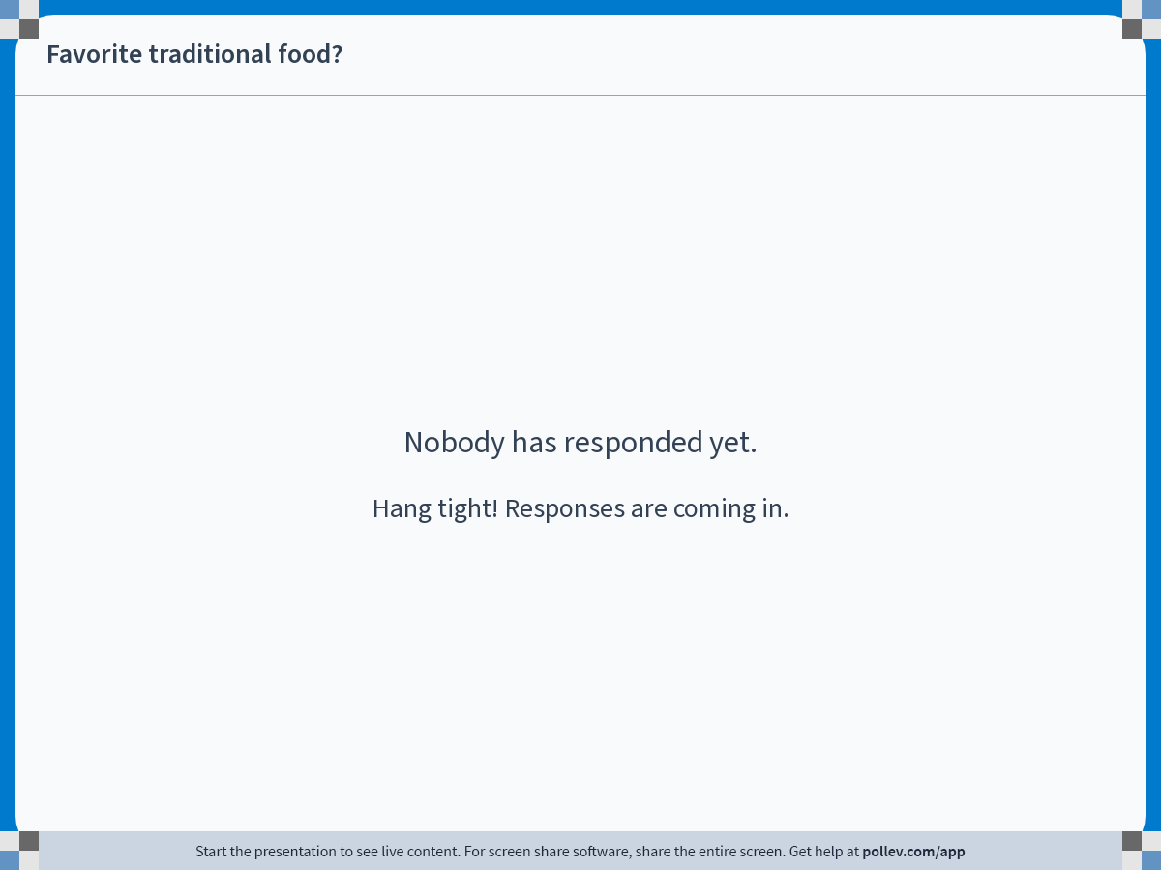
Notes:
Poll Title: Do not modify the notes in this section to avoid tampering with the Poll Everywhere activity. More info at polleverywhere.com/support Favorite traditional food? https://www.polleverywhere.com/free_text_polls/Qzbtq3WXGFZsfs2qwfLR1

Slide 4
Course Overview & Pre-Test
Zender Water & Soil Sampling Course
January 23-25, 2024

Slide 5
Purpose of this Course
The primary focus of this course is to provide the training you need to sample under your QAPPs which are approved by the EPA.
In addition, we will be providing instruction on the State of Alaska’s requirements for conducting groundwater and soil sampling, however, we are unable to provide the full Qualified Sampler Training due to the lack of hands-on instruction. Additionally, the Qualified Sampler title also requires an additional 3 months of oversight by a “Qualified Sampler” during sampling activities to meet the state’s requirements

Slide 6
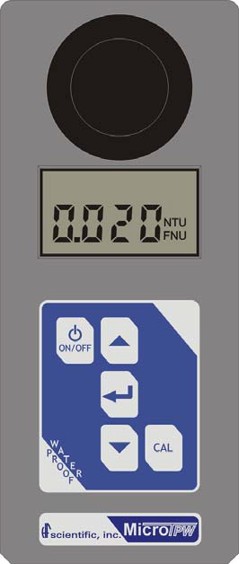
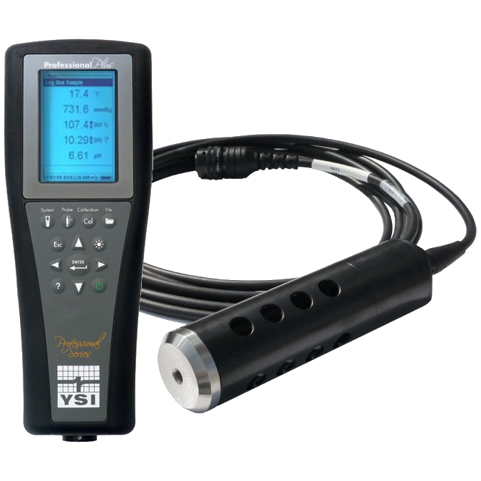
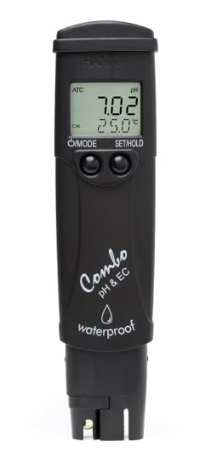
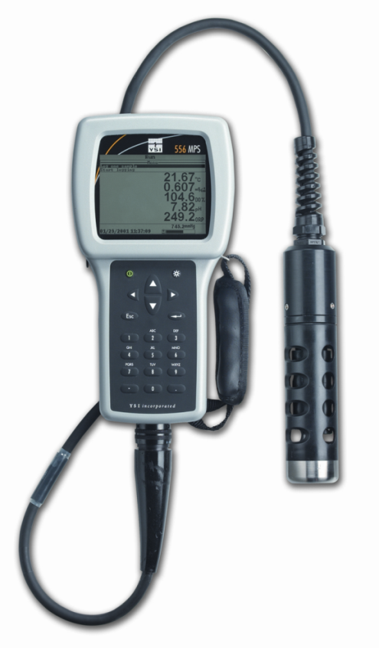
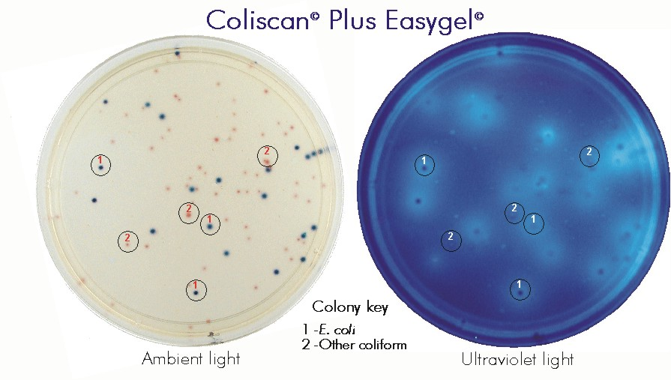
Course Equipment
During this course we will be providing instruction about additional sampling equipment including the YSI 556, YSI Professional, Hanna Combo Meter, Hach Turbidity Meter, Global Flow Probe, and the Coliscan easygel coliform sampling kits

Slide 7
Things to Keep in Mind
During this course we will be providing information on the State of Alaska’s requirements for environmental sampling
The State’s standards may not be applicable to the sampling you perform under your QAPPs – which are directed by the EPA
They will apply if you are sampling due to a reported spill, working on a contaminated site, or using State of Alaska Brownfields in which the state has oversight over

Slide 8
Dress Appropriately
We will be working outside and collecting field samples Wednesday afternoon and Thursday so please have boots/waders and be prepared for bad weather!

Slide 9
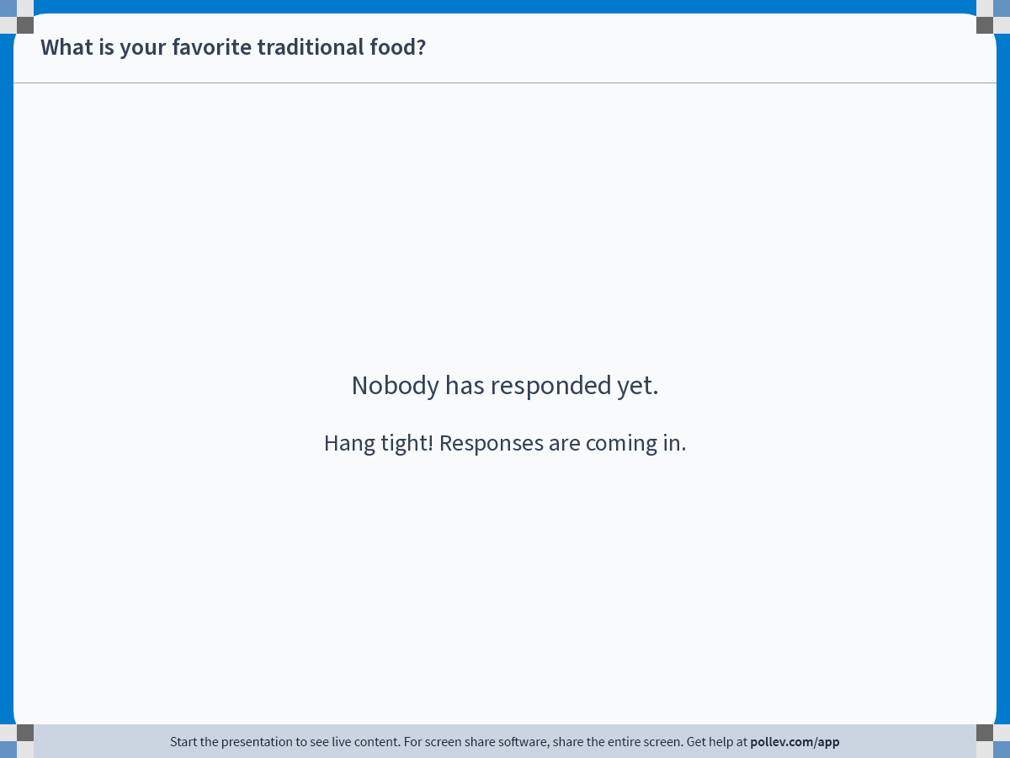
Notes:
Poll Title: Do not modify the notes in this section to avoid tampering with the Poll Everywhere activity. More info at polleverywhere.com/support What is your favorite traditional food? https://www.polleverywhere.com/free_text_polls/6YVlV55IYb2aAdKkRGyFo

Slide 10
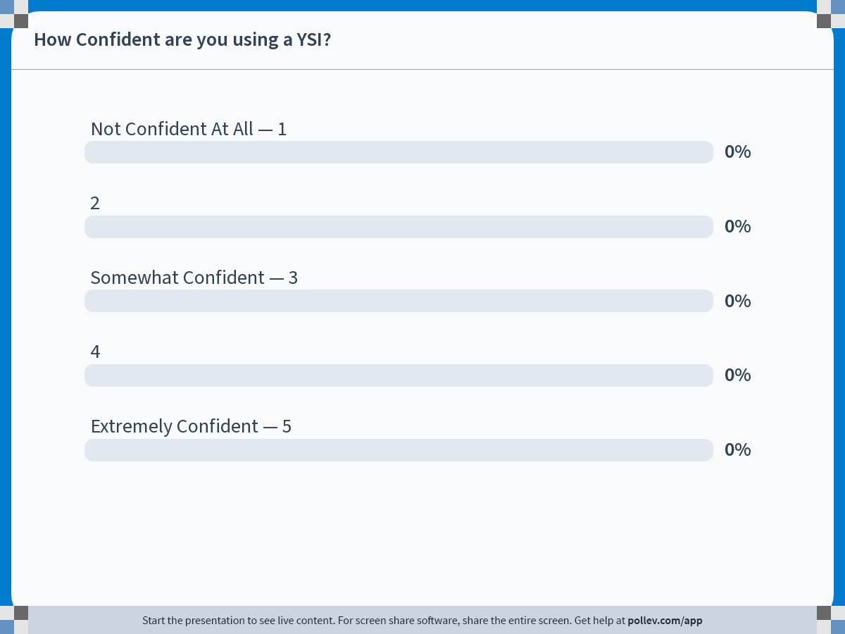
Notes:
Poll Title: Do not modify the notes in this section to avoid tampering with the Poll Everywhere activity. More info at polleverywhere.com/support How Confident are you using a YSI? https://www.polleverywhere.com/multiple_choice_polls/NabKYLacHTTC6TEoI6Hxn?state=opened&flow=Default&onscreen=persist

Slide 11
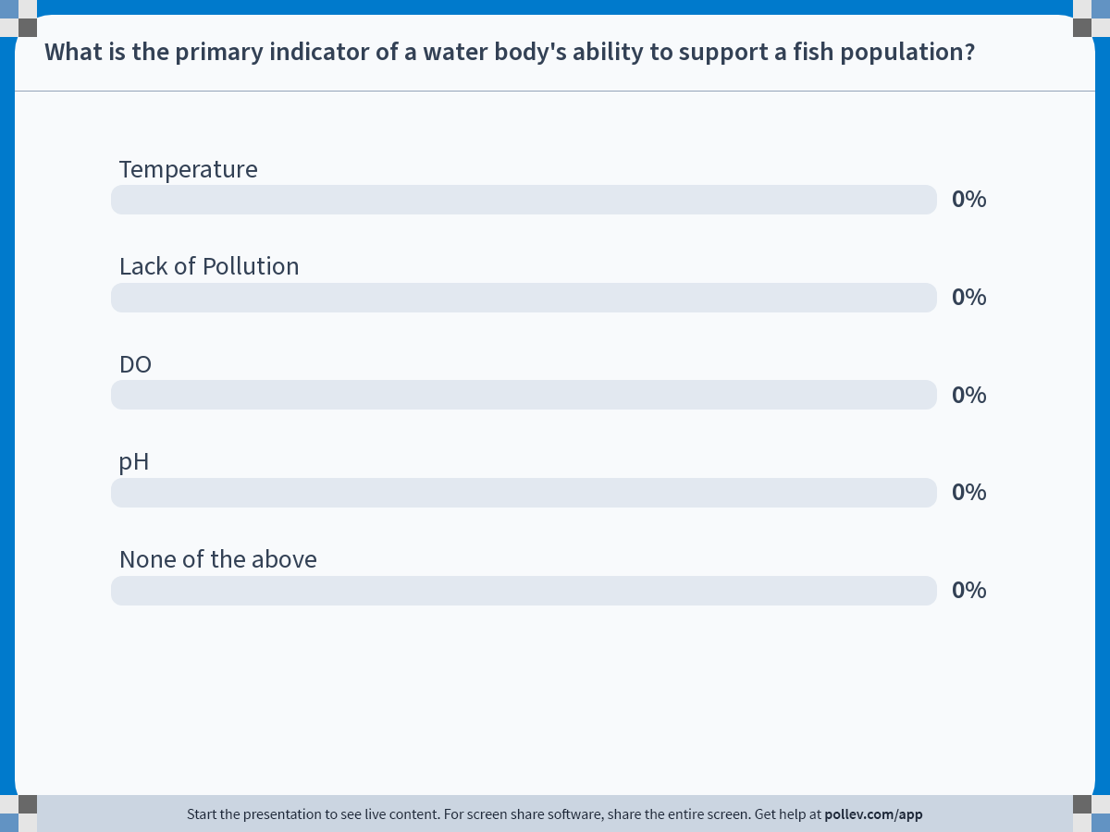
Notes:
Poll Title: Do not modify the notes in this section to avoid tampering with the Poll Everywhere activity. More info at polleverywhere.com/support What is the primary indicator of a water body's ability to support a fish population? https://www.polleverywhere.com/multiple_choice_polls/kYhEaHkvdNctwnC9Ny2C6?state=opened&flow=Default&onscreen=persist

Slide 12
Notes:
Poll Title: Do not modify the notes in this section to avoid tampering with the Poll Everywhere activity. More info at polleverywhere.com/support What is conductivity? https://www.polleverywhere.com/multiple_choice_polls/Z4fYmo6sX0izaMbNJnPky?state=opened&flow=Default&onscreen=persist

Slide 13
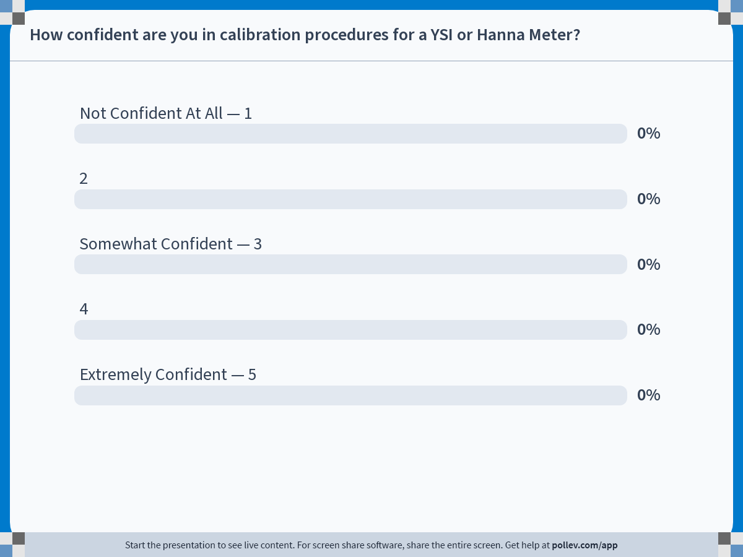
Notes:
Poll Title: Do not modify the notes in this section to avoid tampering with the Poll Everywhere activity. More info at polleverywhere.com/support How confident are you in calibration procedures for a YSI or Hanna Meter? https://www.polleverywhere.com/multiple_choice_polls/UFugcKtYzf830vkCu1Jux?state=opened&flow=Default&onscreen=persist

Slide 14
Notes:
Poll Title: Do not modify the notes in this section to avoid tampering with the Poll Everywhere activity. More info at polleverywhere.com/support What is the term coliform associated with? https://www.polleverywhere.com/multiple_choice_polls/TyMTXRmWDKaIQlsrTxjqA?state=opened&flow=Default&onscreen=persist

Slide 15
Notes:
Poll Title: Do not modify the notes in this section to avoid tampering with the Poll Everywhere activity. More info at polleverywhere.com/support How familiar are you with the water quality parameters that the YSI measures? https://www.polleverywhere.com/multiple_choice_polls/PAsXJpwlv6oIzbvc0Yv1k?state=opened&flow=Default&onscreen=persist

Slide 16
Notes:
Poll Title: Do not modify the notes in this section to avoid tampering with the Poll Everywhere activity. More info at polleverywhere.com/support What is the name of the document that you fill out and return with your lab samples? https://www.polleverywhere.com/multiple_choice_polls/3TAr57Q9ySLgwTWg1JM6m?state=opened&flow=Default&onscreen=persist

Slide 17
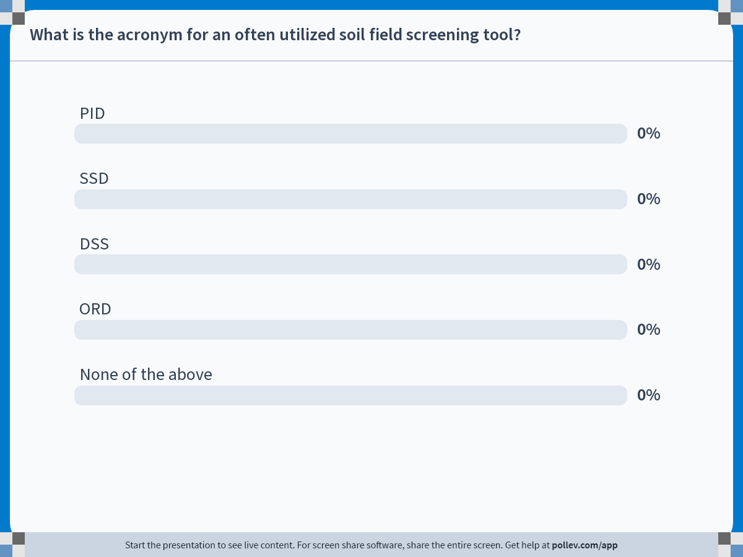
Notes:
Poll Title: Do not modify the notes in this section to avoid tampering with the Poll Everywhere activity. More info at polleverywhere.com/support What is the acronym for an often utilized soil field screening tool? https://www.polleverywhere.com/multiple_choice_polls/QBuQA6FTZAABzqYbdFs9w?state=opened&flow=Default&onscreen=persist

Slide 18
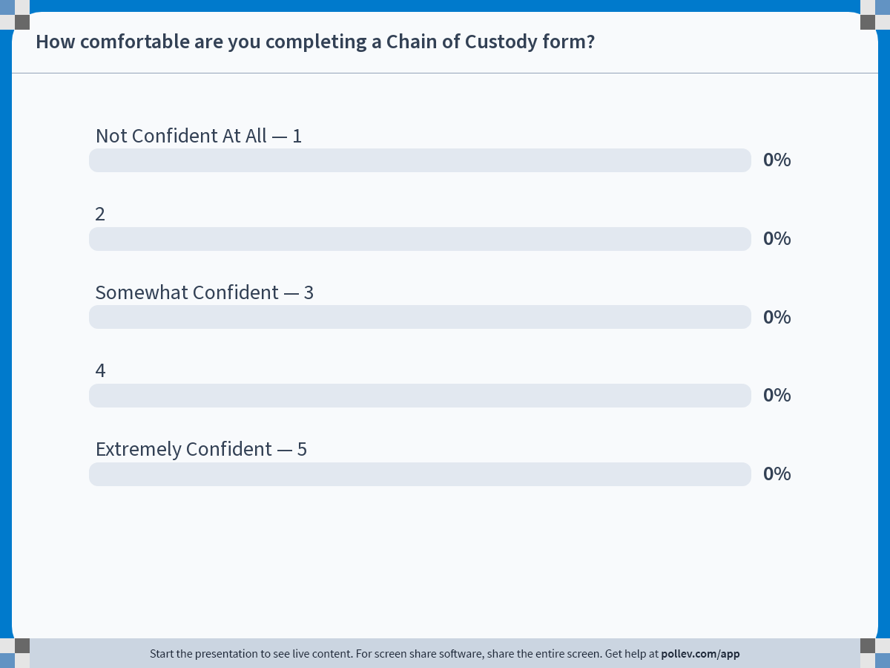
Notes:
Poll Title: Do not modify the notes in this section to avoid tampering with the Poll Everywhere activity. More info at polleverywhere.com/support How comfortable are you completing a Chain of Custody form? https://www.polleverywhere.com/multiple_choice_polls/ULPGP01vcmwPLWy0UidDL?state=opened&flow=Default&onscreen=persist

Slide 19
Notes:
Poll Title: Do not modify the notes in this section to avoid tampering with the Poll Everywhere activity. More info at polleverywhere.com/support What is the term that is used to describe how long you have to submit your laboratory sample once collected? https://www.polleverywhere.com/multiple_choice_polls/Bw8bNM1X1MnXWcxrGm6MB?state=opened&flow=Default&onscreen=persist

Slide 20
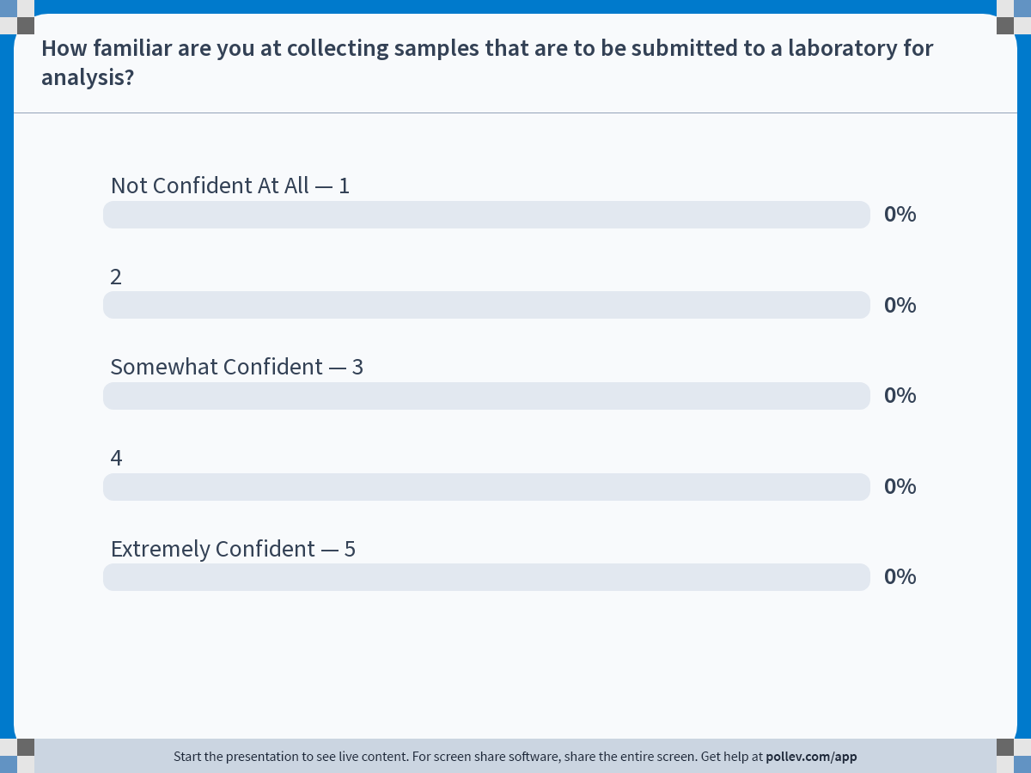
Notes:
Poll Title: Do not modify the notes in this section to avoid tampering with the Poll Everywhere activity. More info at polleverywhere.com/support How familiar are you at collecting samples that are to be submitted to a laboratory for analysis? https://www.polleverywhere.com/multiple_choice_polls/gxeZ4eRfvYHFQ6ulrTPrF?state=opened&flow=Default&onscreen=persist

Slide 21
Questions?

