Slide 1

Data Recording and Record Keeping
Zender Water & Soil Sampling Course
January 23-25, 2024

Slide 2
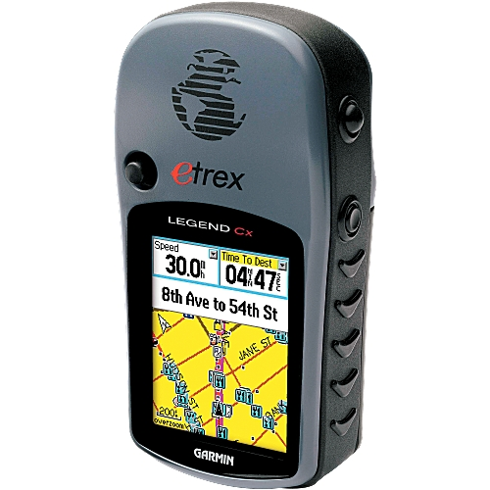
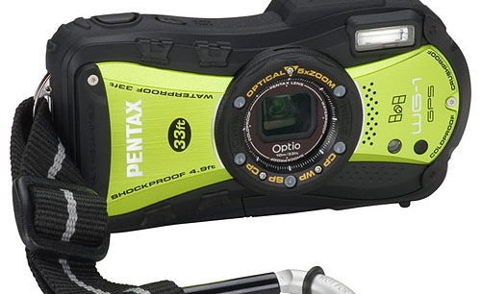
Appropriate Gear
Are you in adverse weather and will your gear withstand it?
  Waterproof, shockproof camera
  Rugged and waterproof GPS units
Be sure you have spare batteries and chargers for your field equipment.
Check that your photo card is in your camera and that there is enough room on your photo card and GPS unit to record information.

Slide 3

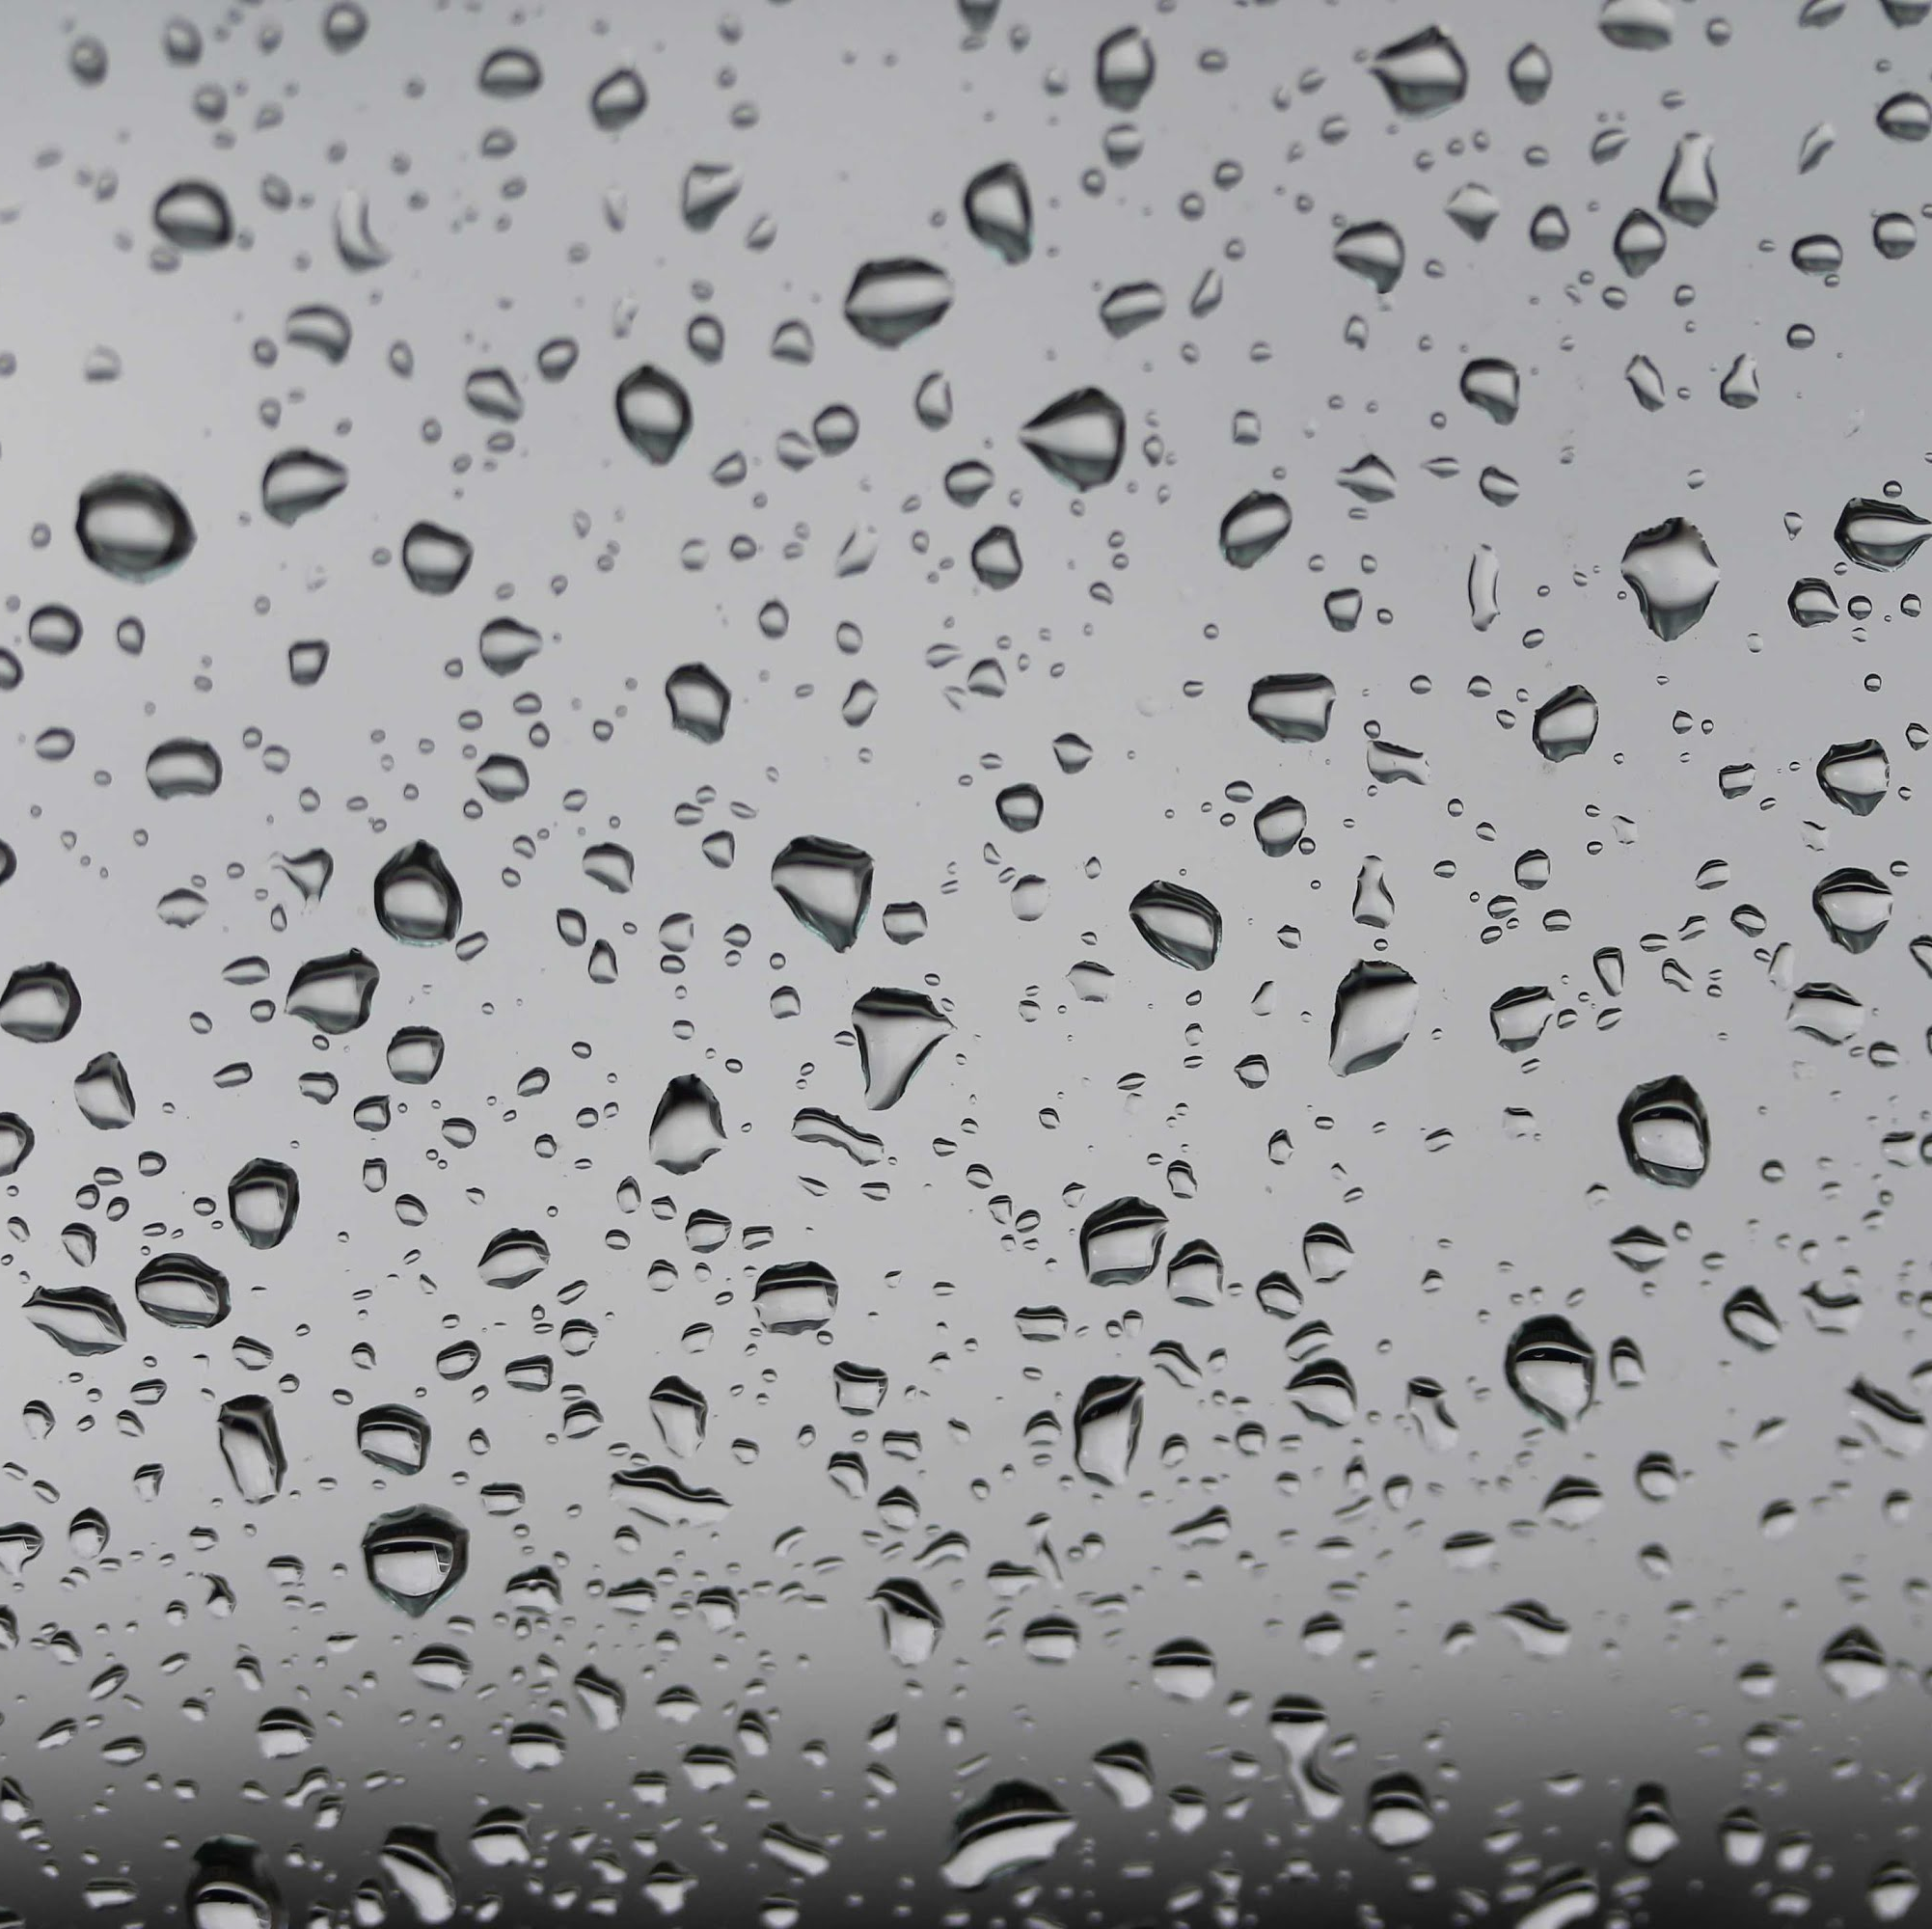
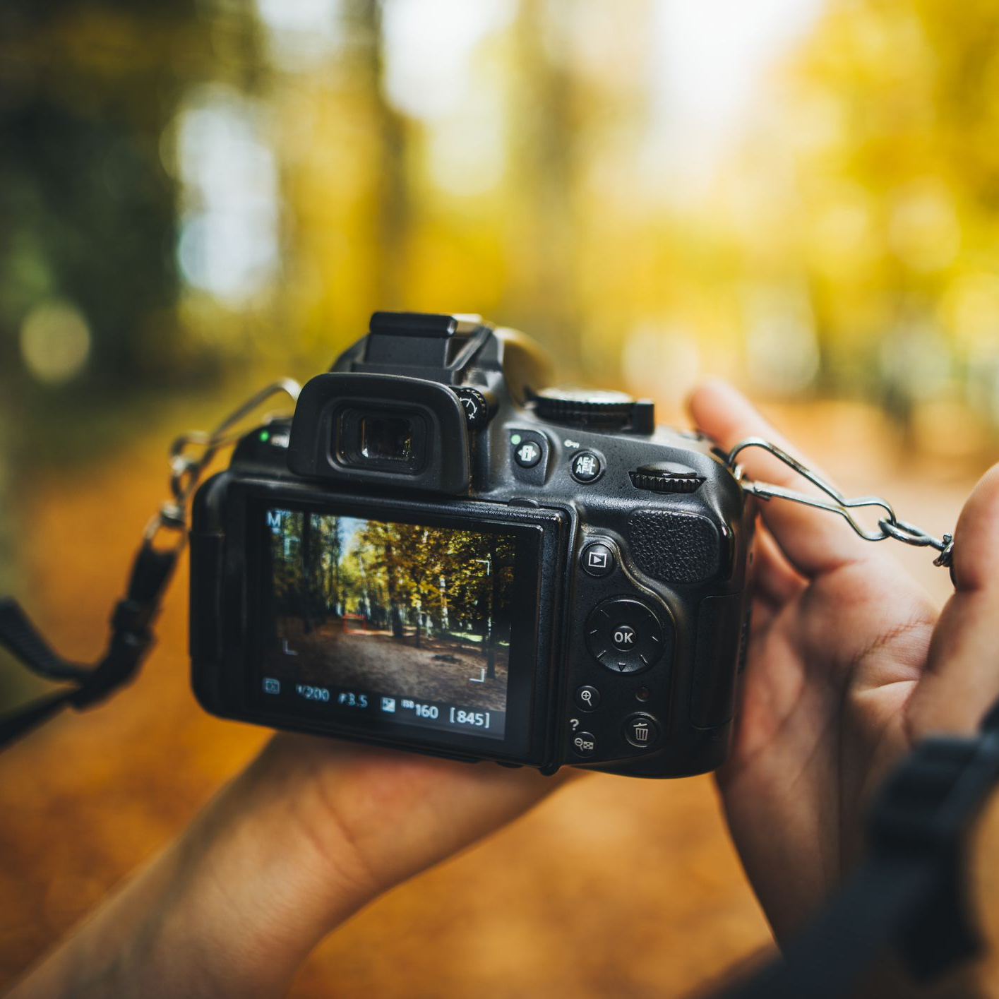
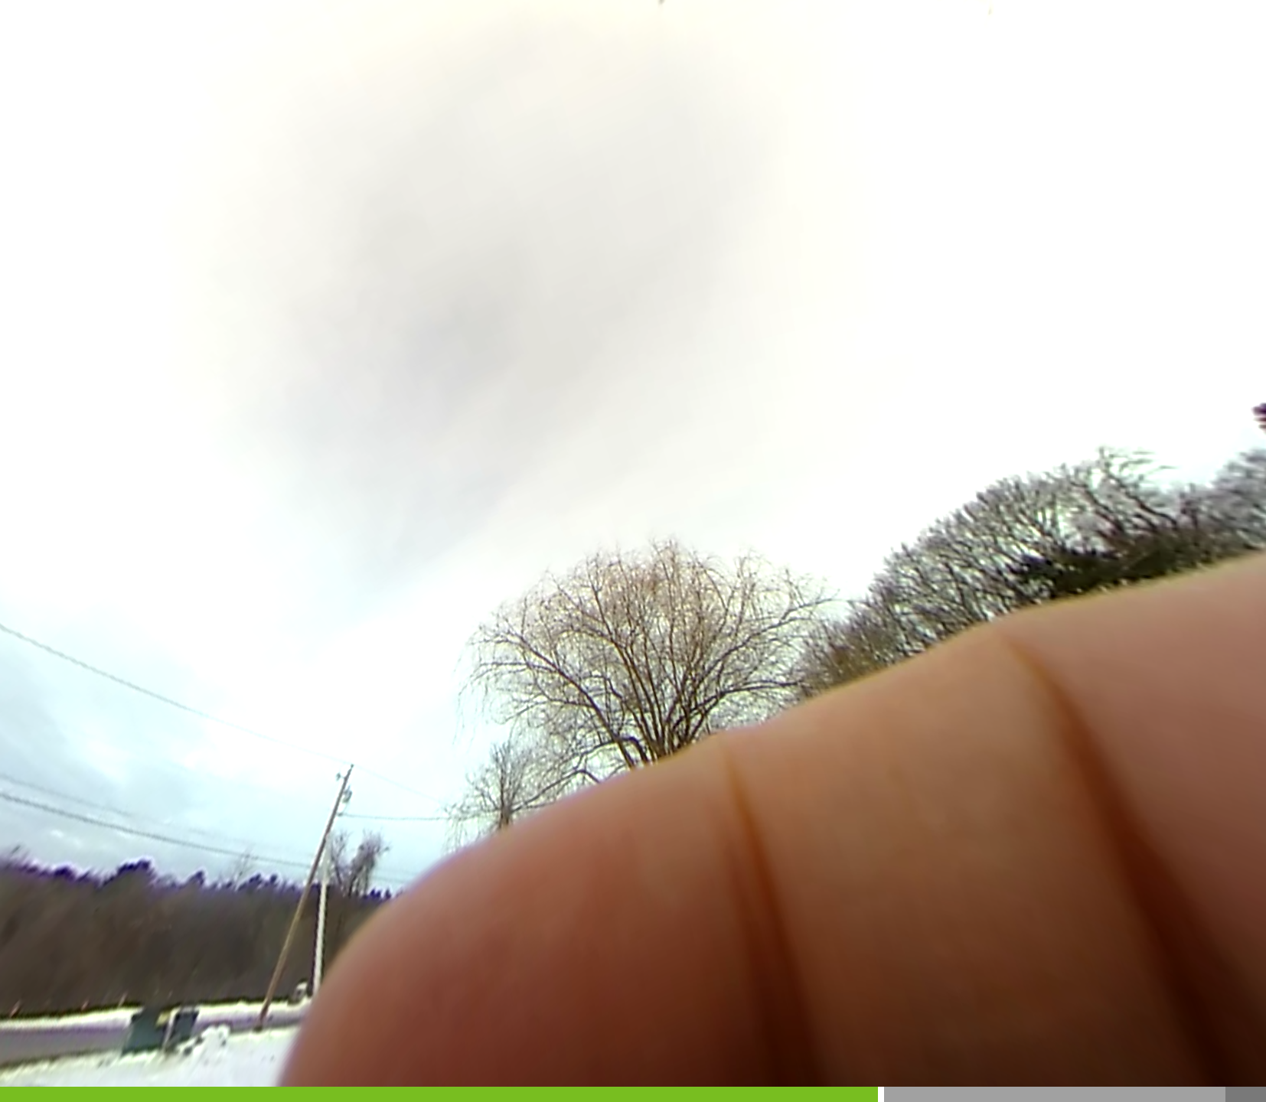
Pictures
Double check pictures after you take them to make sure they represent the conditions.
  Check to see if your finger is in the picture!
  Are raindrops skewing the quality of the photo?
  Is the picture too blurry?
  Did you actually take the picture?
Take notes associated with picture numbers. If you can’t, make sure you have a landmark picture to remember where you were later and to separate out sites.
Set date and time so time stamps are correct.

Slide 4
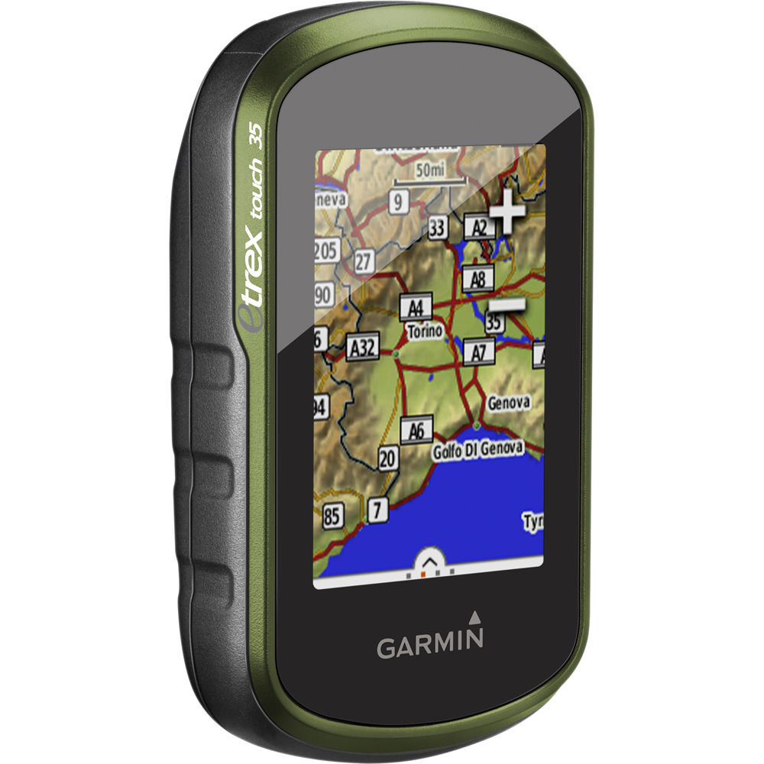
GPS
If you’re using multiple GPS units, be sure to label each unit and indicate on your datasheets which unit you’re using.
Understand the difference between tracks and points, check whether or not your unit automatically records tracks.
Check if there is room on your GPS for new waypoints and data BEFORE heading out into the field.

Slide 5
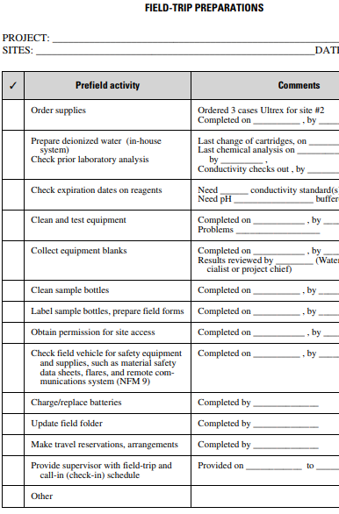
Create a checklist to ensure you have completed all the tasks that are required before you leave to go out into the field!

Slide 6
Collecting Field Data
The information you record in the field could be your one shot to document conditions.
  Make sure datasheets include all the information you want to bring back.
  Don’t be shy about drawing site maps.
  Leave extra room on datasheets to record other observations you may not have planned on recording
  Bring a Rite-in-the-Rain notebook to record additional observations if your data sheets are full
When you make a mistake in your notes, draw a line through the mistake and take a new note. Don’t erase!!

Slide 7
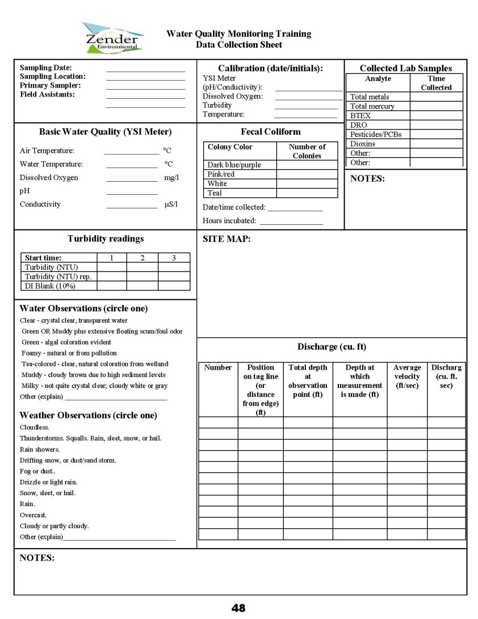
Data Collection Sheet

Slide 8
Data Sheet/Field Log Entries
Project name/Site ID/Client/Page Number
Date
Weather, site conditions, and other salient observations
Full name of on-site personnel
Daily objectives
Time and location of activities
Field observations and comments
Deviations from the CSP site-specific approved work plan or QAPP
Photographic log (photographic name, roll or frame number, description of photograph, date, and time)
Site sketches with reference to north direction, sample and field screening locations and depths, and on-site groundwater flow direction
Survey and location (latitude and longitude coordinates when possible)
All field measurements (e.g. leak check results, geochemical parameters, field screening results)
Daily equipment calibrations and maintenance
Sample record (sample identification, date, time, media, number of samples, and location)
Cleanup or remediation activities (system performance, system calibration or maintenance record, excavation activities and volume of material removed)

Slide 9
Follow Up
Double check to make sure all datasheets are complete before leaving the field.
Transfer information from datasheets to electronic spreadsheets ASAP to recall as much information as possible (it is much harder to go back and try to do this later).
Photocopy/scan datasheets to have back-up copies in case something happens to your originals.
In most cases, when grants require a QAPP they also require you to store your data in two separate locations. This includes on-site and off-site locations for electronic data.

Slide 10
Questions?
Other Tips?
Developed by Zender Environmental (2016)

