Slide 1

Evals &
Post-Test
Zender Water & Soil Sampling Course
January 23-25, 2024

Slide 2

Evaluations

Slide 3
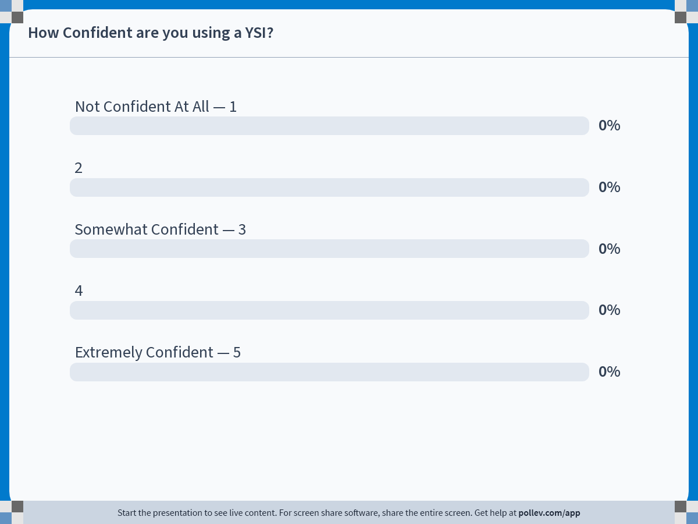
Notes:
Poll Title: Do not modify the notes in this section to avoid tampering with the Poll Everywhere activity.
More info at polleverywhere.com/support
How Confident are you using a YSI?
https://www.polleverywhere.com/multiple_choice_polls/NabKYLacHTTC6TEoI6Hxn?state=opened&flow=Default&onscreen=persist

Slide 4
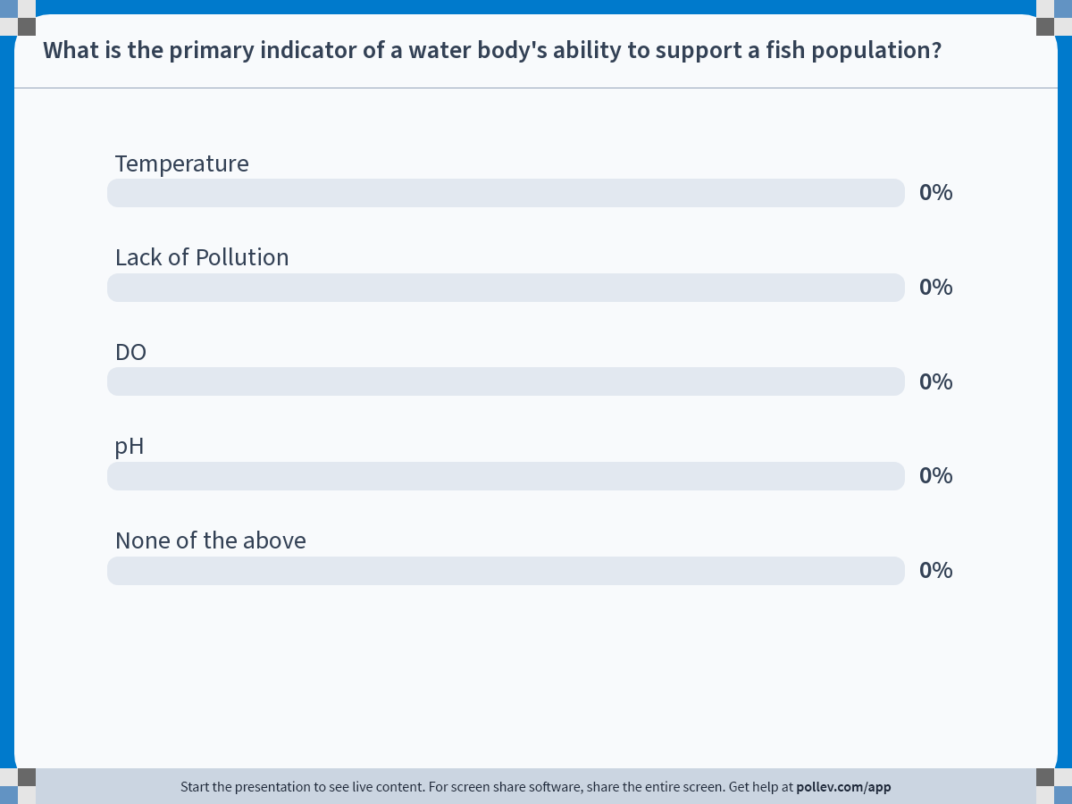
Notes:
Poll Title: Do not modify the notes in this section to avoid tampering with the Poll Everywhere activity.
More info at polleverywhere.com/support
What is the primary indicator of a water body's ability to support a fish population?
https://www.polleverywhere.com/multiple_choice_polls/kYhEaHkvdNctwnC9Ny2C6?state=opened&flow=Default&onscreen=persist

Slide 5
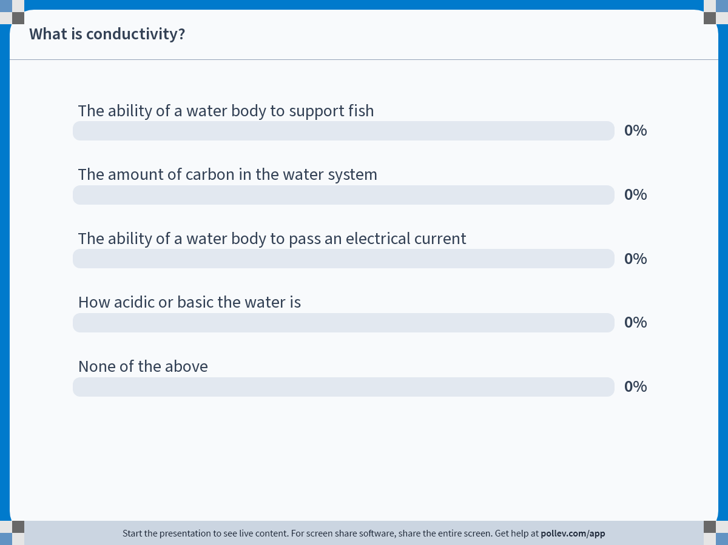
Notes:
Poll Title: Do not modify the notes in this section to avoid tampering with the Poll Everywhere activity.
More info at polleverywhere.com/support
What is conductivity?
https://www.polleverywhere.com/multiple_choice_polls/Z4fYmo6sX0izaMbNJnPky?state=opened&flow=Default&onscreen=persist

Slide 6
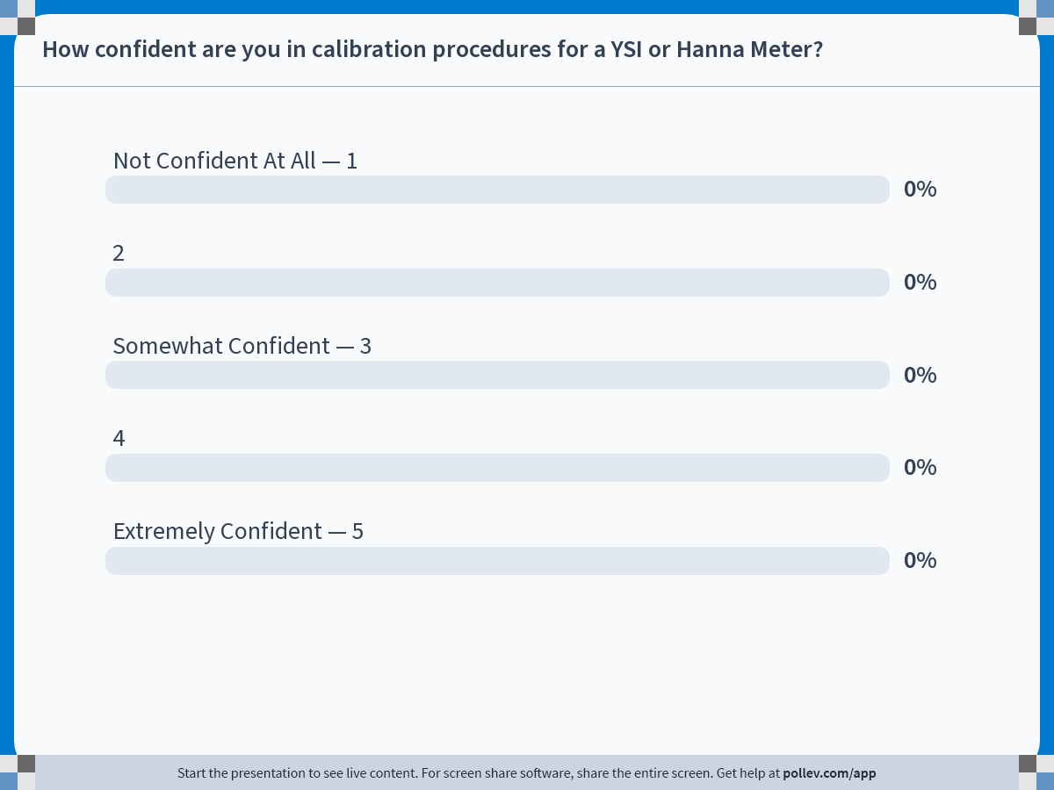
Notes:
Poll Title: Do not modify the notes in this section to avoid tampering with the Poll Everywhere activity.
More info at polleverywhere.com/support
How confident are you in calibration procedures for a YSI or Hanna Meter?
https://www.polleverywhere.com/multiple_choice_polls/UFugcKtYzf830vkCu1Jux?state=opened&flow=Default&onscreen=persist

Slide 7
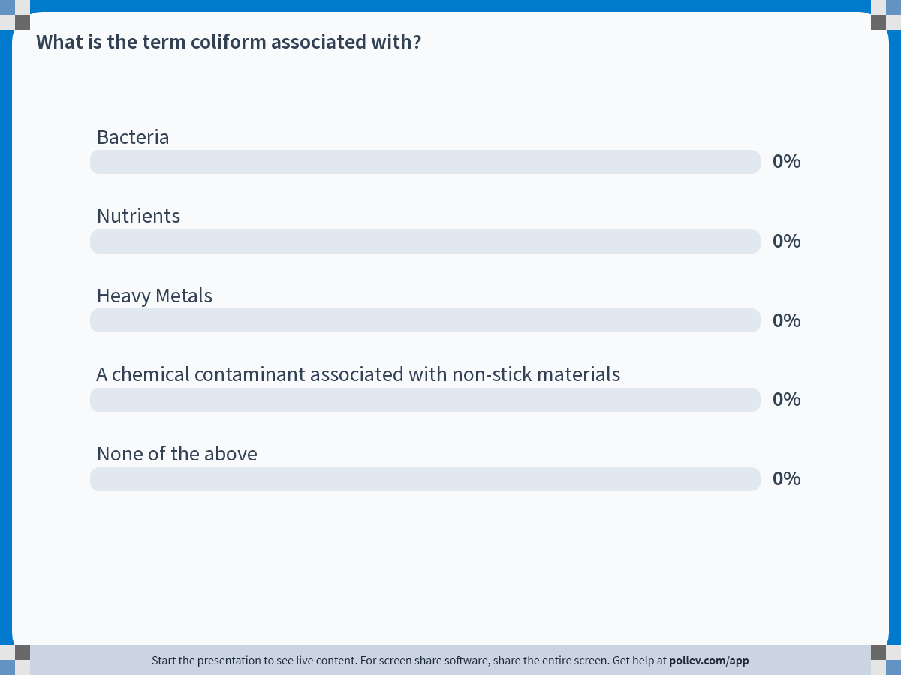
Notes:
Poll Title: Do not modify the notes in this section to avoid tampering with the Poll Everywhere activity.
More info at polleverywhere.com/support
What is the term coliform associated with?
https://www.polleverywhere.com/multiple_choice_polls/TyMTXRmWDKaIQlsrTxjqA?state=opened&flow=Default&onscreen=persist

Slide 8
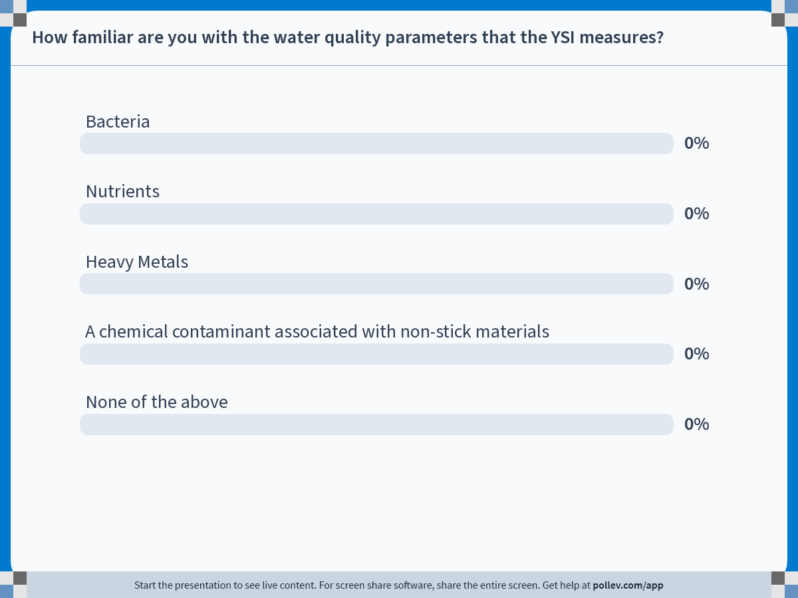
Notes:
Poll Title: Do not modify the notes in this section to avoid tampering with the Poll Everywhere activity.
More info at polleverywhere.com/support
How familiar are you with the water quality parameters that the YSI measures?
https://www.polleverywhere.com/multiple_choice_polls/PAsXJpwlv6oIzbvc0Yv1k?state=opened&flow=Default&onscreen=persist

Slide 9
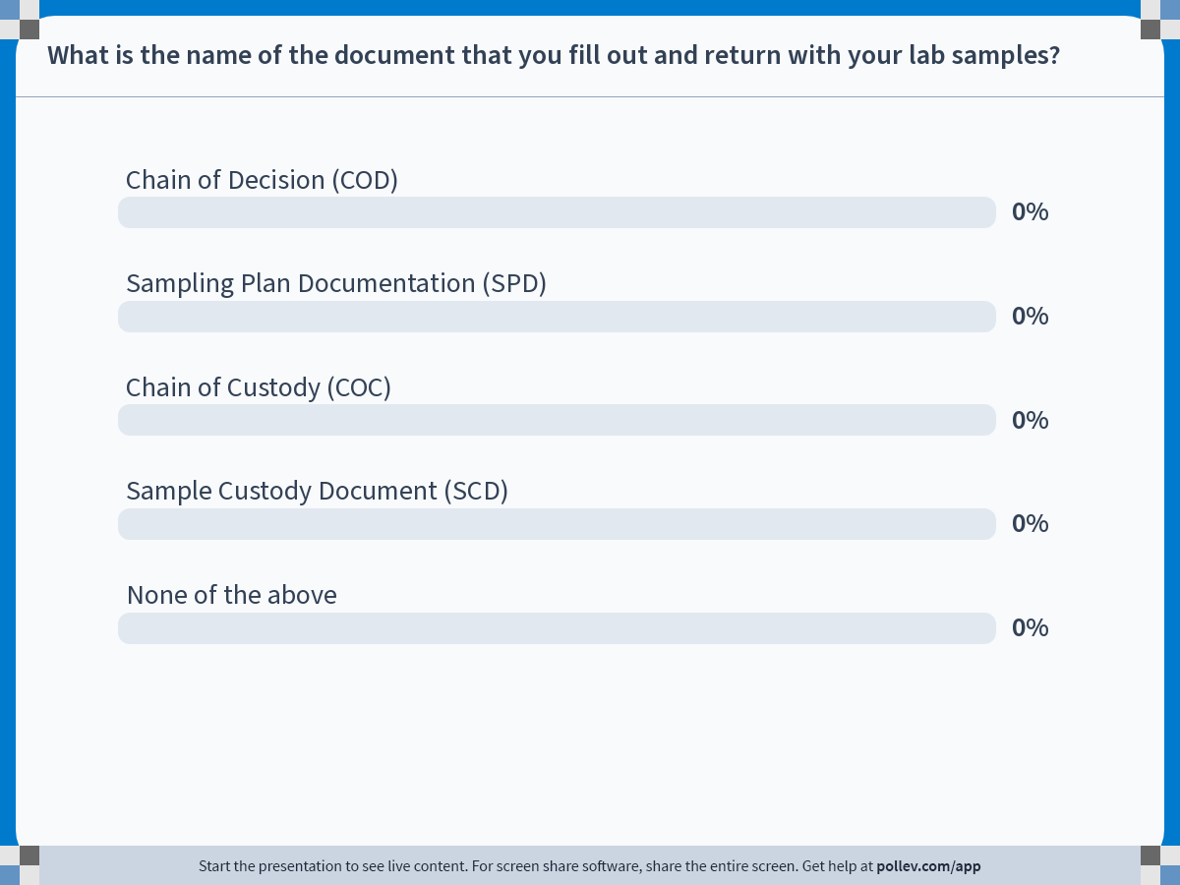
Notes:
Poll Title: Do not modify the notes in this section to avoid tampering with the Poll Everywhere activity.
More info at polleverywhere.com/support
What is the name of the document that you fill out and return with your lab samples?
https://www.polleverywhere.com/multiple_choice_polls/3TAr57Q9ySLgwTWg1JM6m?state=opened&flow=Default&onscreen=persist

Slide 10
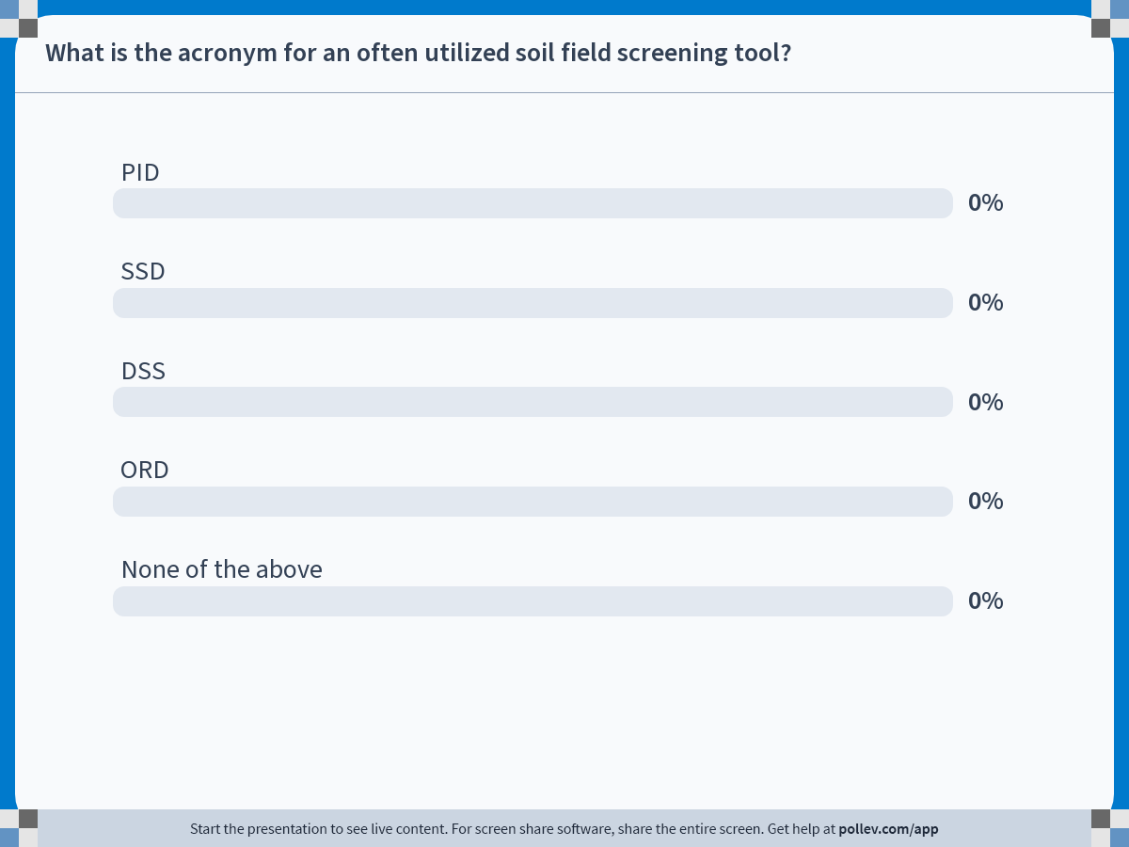
Notes:
Poll Title: Do not modify the notes in this section to avoid tampering with the Poll Everywhere activity.
More info at polleverywhere.com/support
What is the acronym for an often utilized soil field screening tool?
https://www.polleverywhere.com/multiple_choice_polls/QBuQA6FTZAABzqYbdFs9w?state=opened&flow=Default&onscreen=persist

Slide 11
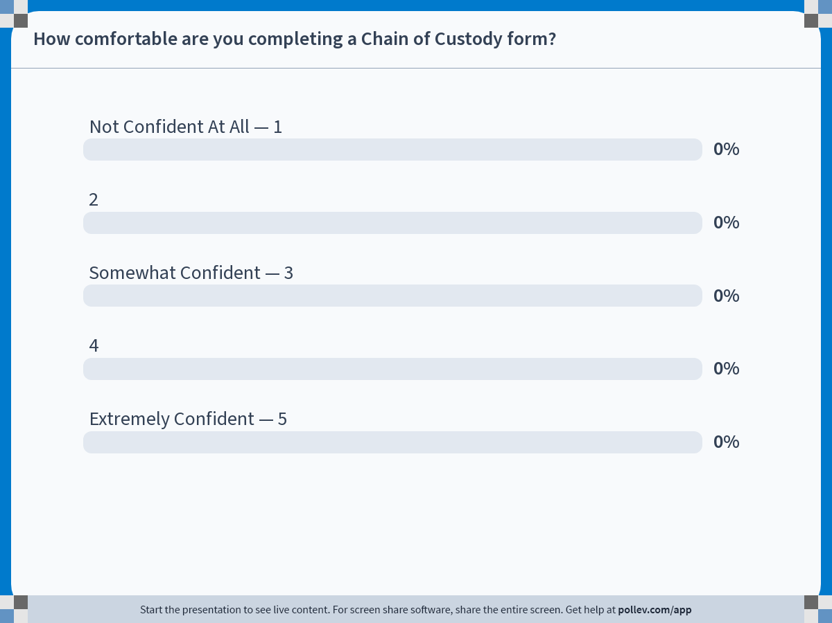
Notes:
Poll Title: Do not modify the notes in this section to avoid tampering with the Poll Everywhere activity.
More info at polleverywhere.com/support
How comfortable are you completing a Chain of Custody form?
https://www.polleverywhere.com/multiple_choice_polls/ULPGP01vcmwPLWy0UidDL?state=opened&flow=Default&onscreen=persist

Slide 12
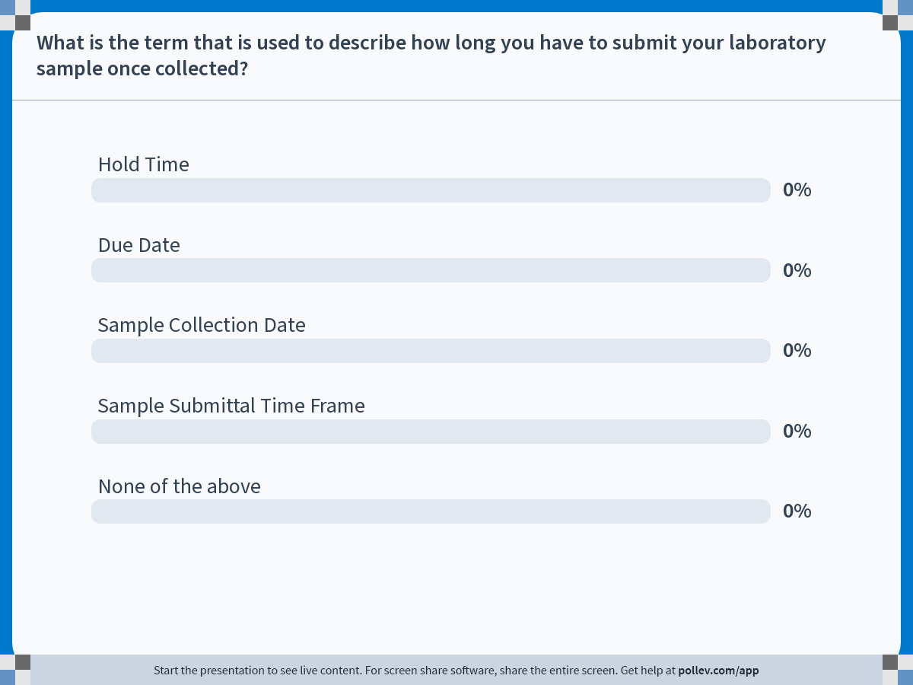
Notes:
Poll Title: Do not modify the notes in this section to avoid tampering with the Poll Everywhere activity.
More info at polleverywhere.com/support
What is the term that is used to describe how long you have to submit your laboratory sample once collected?
https://www.polleverywhere.com/multiple_choice_polls/Bw8bNM1X1MnXWcxrGm6MB?state=opened&flow=Default&onscreen=persist

Slide 13
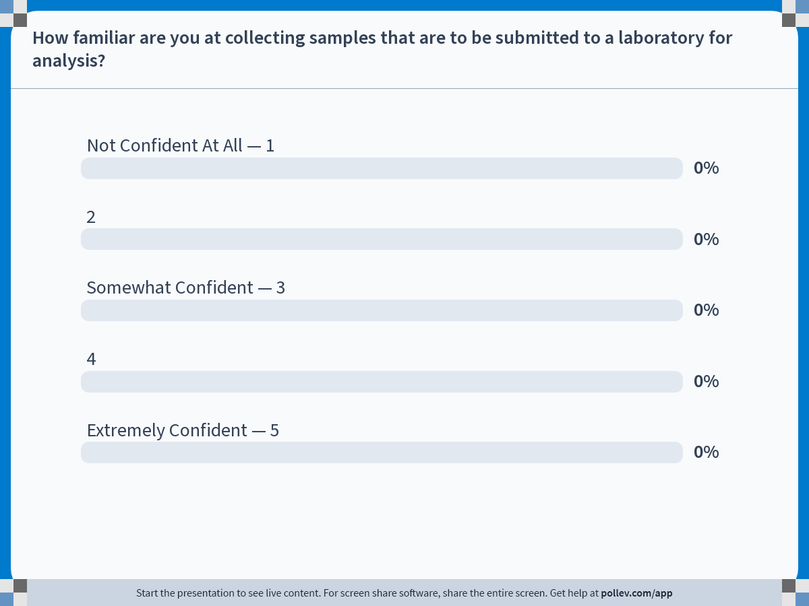
Notes:
Poll Title: Do not modify the notes in this section to avoid tampering with the Poll Everywhere activity.
More info at polleverywhere.com/support
How familiar are you at collecting samples that are to be submitted to a laboratory for analysis?
https://www.polleverywhere.com/multiple_choice_polls/gxeZ4eRfvYHFQ6ulrTPrF?state=opened&flow=Default&onscreen=persist

Slide 14


Questions?

