Slide 1


Groundwater Sampling
Zender Water & Soil Sampling Course
January 23-25, 2024

Slide 2

https://www.youtube.com/watch?v=oNWAerr_xEE

Slide 3
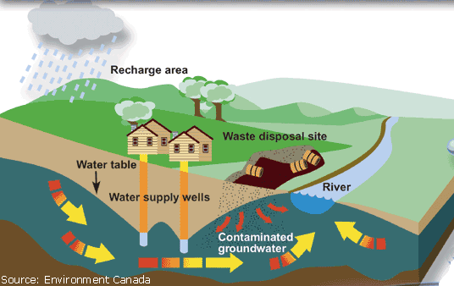
Transport of Soil Contamination & Impacts on Groundwater

Slide 4
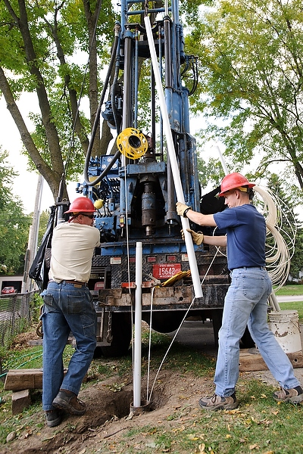
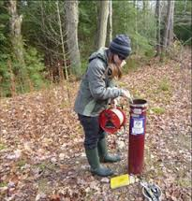
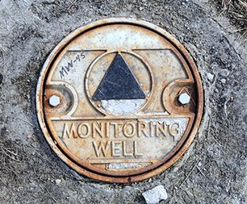
Groundwater Contamination
Depth to groundwater?
  Which aquifers are impacted?
  Is there a confining layer?
Flow direction?
  Is there a potential for the groundwater contamination to negatively impact a nearby water body?
Health and safety?
  Are there any water-supply wells in the area?
Where is the source area?
  Can the source area be remediated?
  Is there free-product present?

Slide 5
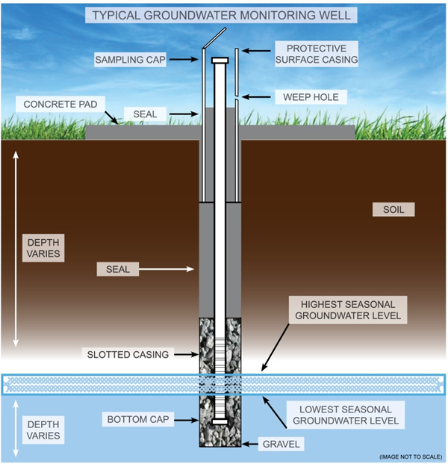
Typical Groundwater Monitoring Well

Slide 6
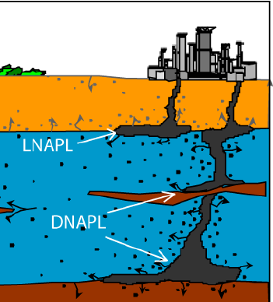
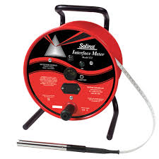
Determine if Free-Product is Present
In some cases, highly-contaminated aquifers may contain a floating layer of Non-aqueous phase liquids (NAPLs) or contaminants that do no dissolve or mix easily with water
You can utilize an oil-water interface probe to determine the presence of, and amount of NAPL in you water column.

Slide 7
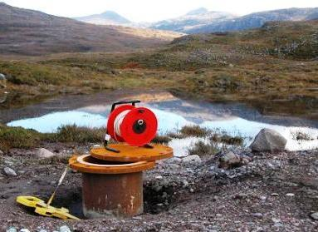
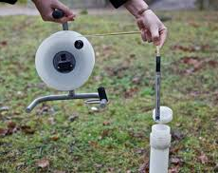
Groundwater Monitoring Well Measurements
Prior to purging and sampling, three measurements need to be recorded:
The inside diameter of the well
The depth to water in the well
The depth to the bottom of the well.
With that information, the volume of the water in the well casing can be calculated and recorded.

Slide 8
Groundwater Monitoring Well Measurements
Prior to purging and sampling, three measurements need to be recorded:
The inside diameter of the well
The depth to water in the well
The depth to the bottom of the well
With that information, the volume of the water in the well casing can be calculated and recorded.

Slide 9
Determine Well Volume
Well Volume Example Calculation:
Subtract the depth to water from the total depth of the well to find the height of the water column in feet
Multiply that number by 0.16 (if you have a 2-inch well) to calculate the volume of water in the well casing (0.16 represents the number of gallons per foot of water in the well)
  Most wells are typically 2-inches in diameter. Check with your driller and/or QAPP if you are unsure.

Slide 10
Well Volume Exercise
2” PVC
15 Feet BGS
_
10 Feet BGS
=
5
x
0.16
=
0.8 Gallons

Slide 11
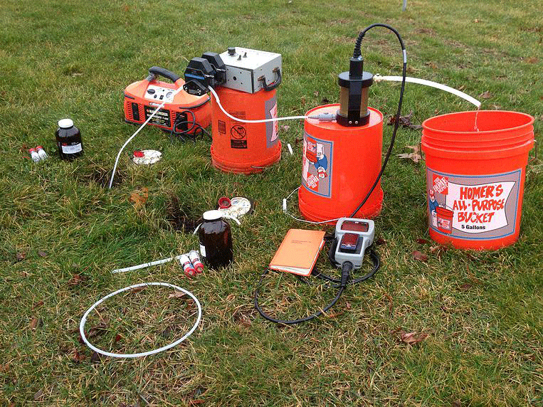
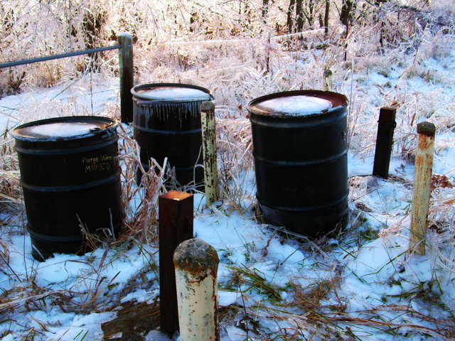
Purging of the Monitoring Well
Purging is the process of removing stagnant water from a monitoring well prior to sampling
Purging is usually conducted utilizing your bladder pump and a flow-through cell
Containerize all purge water until laboratory results show that no contamination exists.
Label each container with:
  Monitoring well number
  The time and date
  Your contact information

Slide 12
Prior to Collecting Samples
  At least 3 well volumes should be removed (purged) or water quality parameters should have stabilized.
    Purging is done using low-flow techniques ensuring that the well drawdown doesn’t exceed 0.3 feet
    Flow rates are required to be between 50-500 mL/min
  Water quality parameters are considered stable when three successive readings, collected 3-5 minutes apart, are within ADEC standards.
  A minimum of three (minimum of four if using temperature as an indicator) of these parameters must be monitored and recorded.
      ± 3% for temperature (minimum of ± 0.2oC),
      ± 0.1 for pH,
      ± 3% for conductivity,
      ± 10% for dissolved oxygen (DO), and
      ± 10% for turbidity

Slide 13
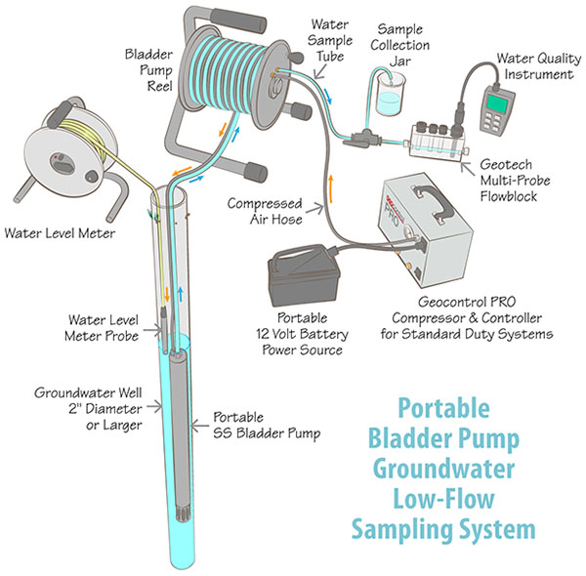
Typical Groundwater Sampling System

Slide 14
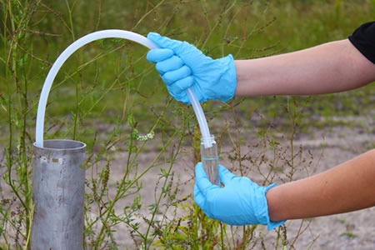
Collection of Groundwater Samples for Laboratory Analysis
Water samples should generally be collected from the top 1 foot of the water table
Collect volatile samples first
Determine if the jar/bottle requires no headspace
Fill sample bottles to laboratory specifications to ensure that you do not overfill sample bottles and spill preservatives

Slide 15
Questions?
Other Tips?
Developed by Zender Environmental (2016)

