Slide 1
Laboratory Sample Ordering & Submission
Zender Water & Soil Sampling Course
January 23-25, 2024

Slide 2
Ordering Your Sample Kit
You should provide the laboratory with:
The Project name
The date you need the results by
How the samples will be shipped (i.e. airline, etc.)
What type of analyses you need performed
Number of samples – including QC samples
How many trip blanks you will need

Slide 3
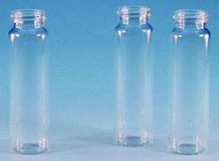
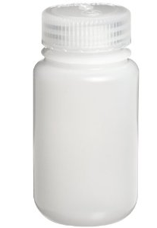
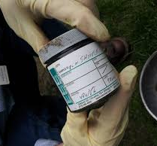
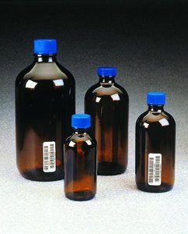
Example Sample Bottles & Jars

Slide 4
Example Sample Kit Contents
When you receive your sample kit do an inventory of all of its contents to ensure that you have everything you need.

Slide 5
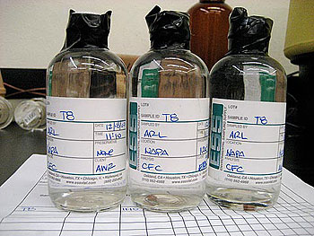
Sample Labels
Sample jars must be individually labeled so that the lab is able to identify which jars receive which analysis
The unique identifier is called a Sample ID
The Sample ID also allows you to keep track of your samples when you receive the results
The construction of the Sample IDs are typically decided prior to the sampling event are generally noted in the workplan or QAPP All information on the sample jars, including the Sample ID, should correspond to the information you enter into the Chain of Custody (CoC)

Slide 6
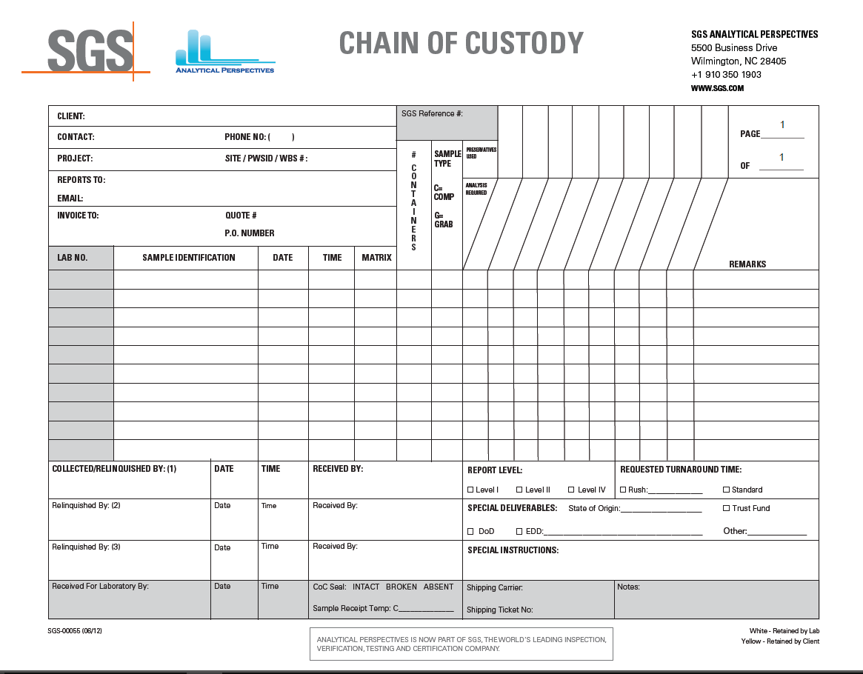
Chain of Custody

Slide 7
Chain of Custody
Completely filling out the Chain of Custody (COC) is vital.
Please be sure to include:
all sample collection dates and times (military time only)
sample IDs (as you wish them to be reported)
analytical tests requested
company name and address
project name, project contact, phone number and email address
It is important that this information match that provided on the labels
In order to fully relinquish the samples you must sign, date and record time you transferred the samples to the laboratory. If you are shipping the samples, relinquish the COC at the time you hand over the samples to the shipper

Slide 8
Packing the Cooler

Slide 9
Packing the Cooler

Slide 10
Packing the Cooler

Slide 11
Tips for Packing the Cooler
Ensure that all bottles/jars are standing upright and that they are wrapped appropriately to prevent breakage
Make sure that you fill any empty space with additional packing material
Double check to make sure you have included your trip blank(s) and your temperature blank
Make a copy of the COC for your records and place the original inside a Ziploc bag – preferably taped to the inside of the cooler lid
Complete the process by placing signed custody seals over the cooler lid

