Slide 1
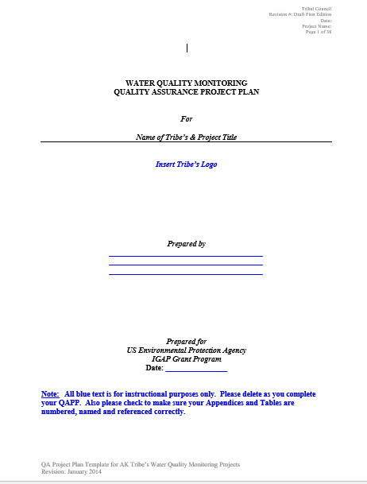
Quality Assurance Project Plans (QAPP)
Blueprint for Your Investigation

Slide 2
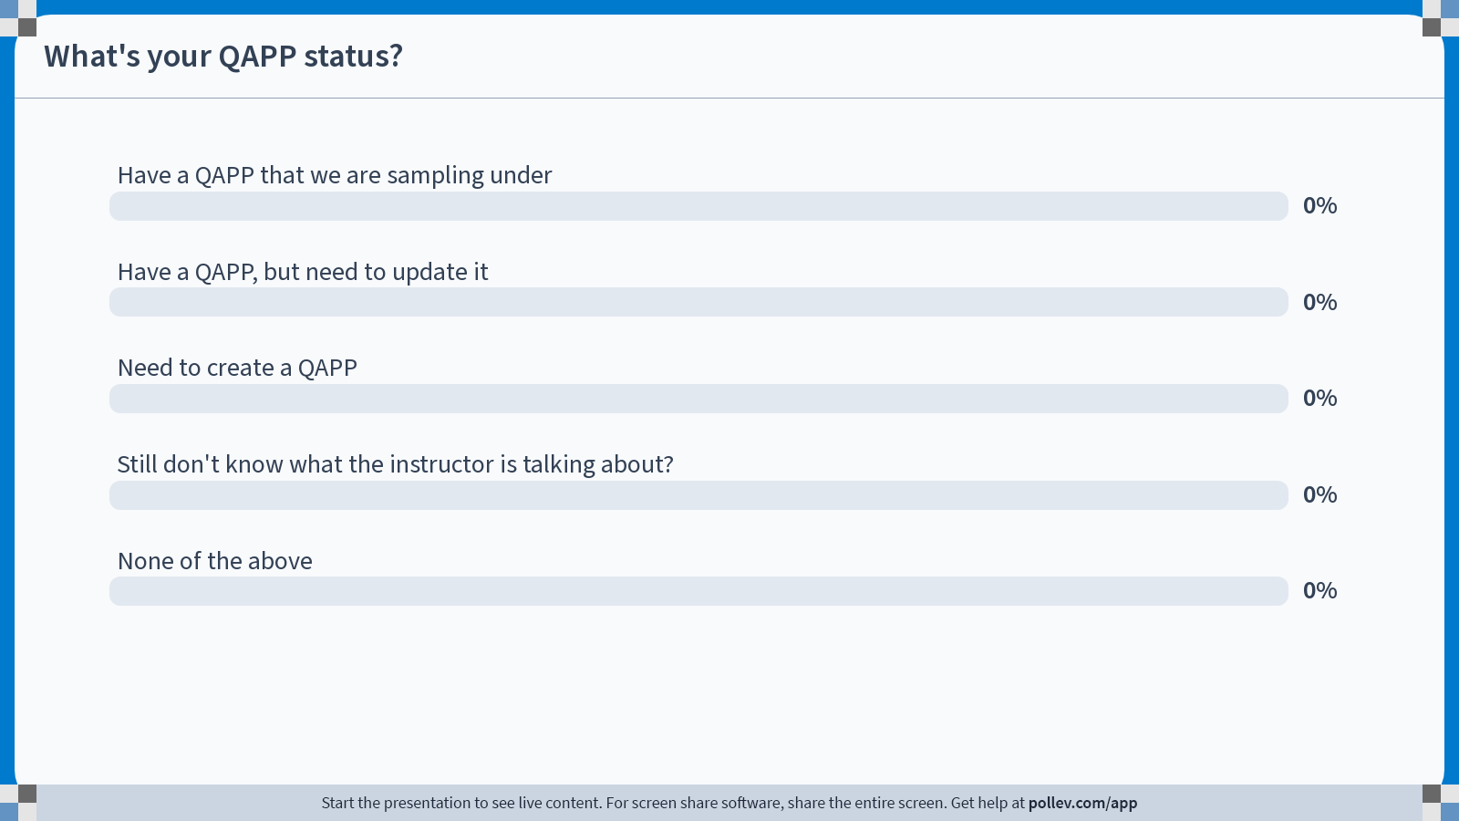
Notes:
Poll Title: Do not modify the notes in this section to avoid tampering with the Poll Everywhere activity.
More info at polleverywhere.com/support
What's your QAPP status?
https://www.polleverywhere.com/multiple_choice_polls/hqw70x1FALb9xo4fAT4Gx?state=opened&flow=Default&onscreen=persist

Slide 3
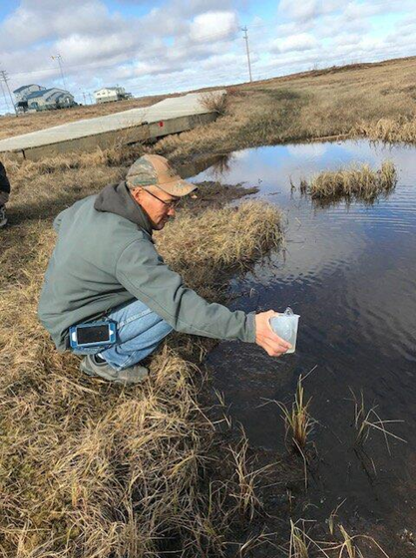
Quality Assurance Project Plan (QAPP)
Allows you to think through the process before beginning
Ensures that you are collecting the right information to answer your questions
Gives you an opportunity to receive feedback and advice from people with a lot of experience
Think who, what, when, why and how!

Slide 4
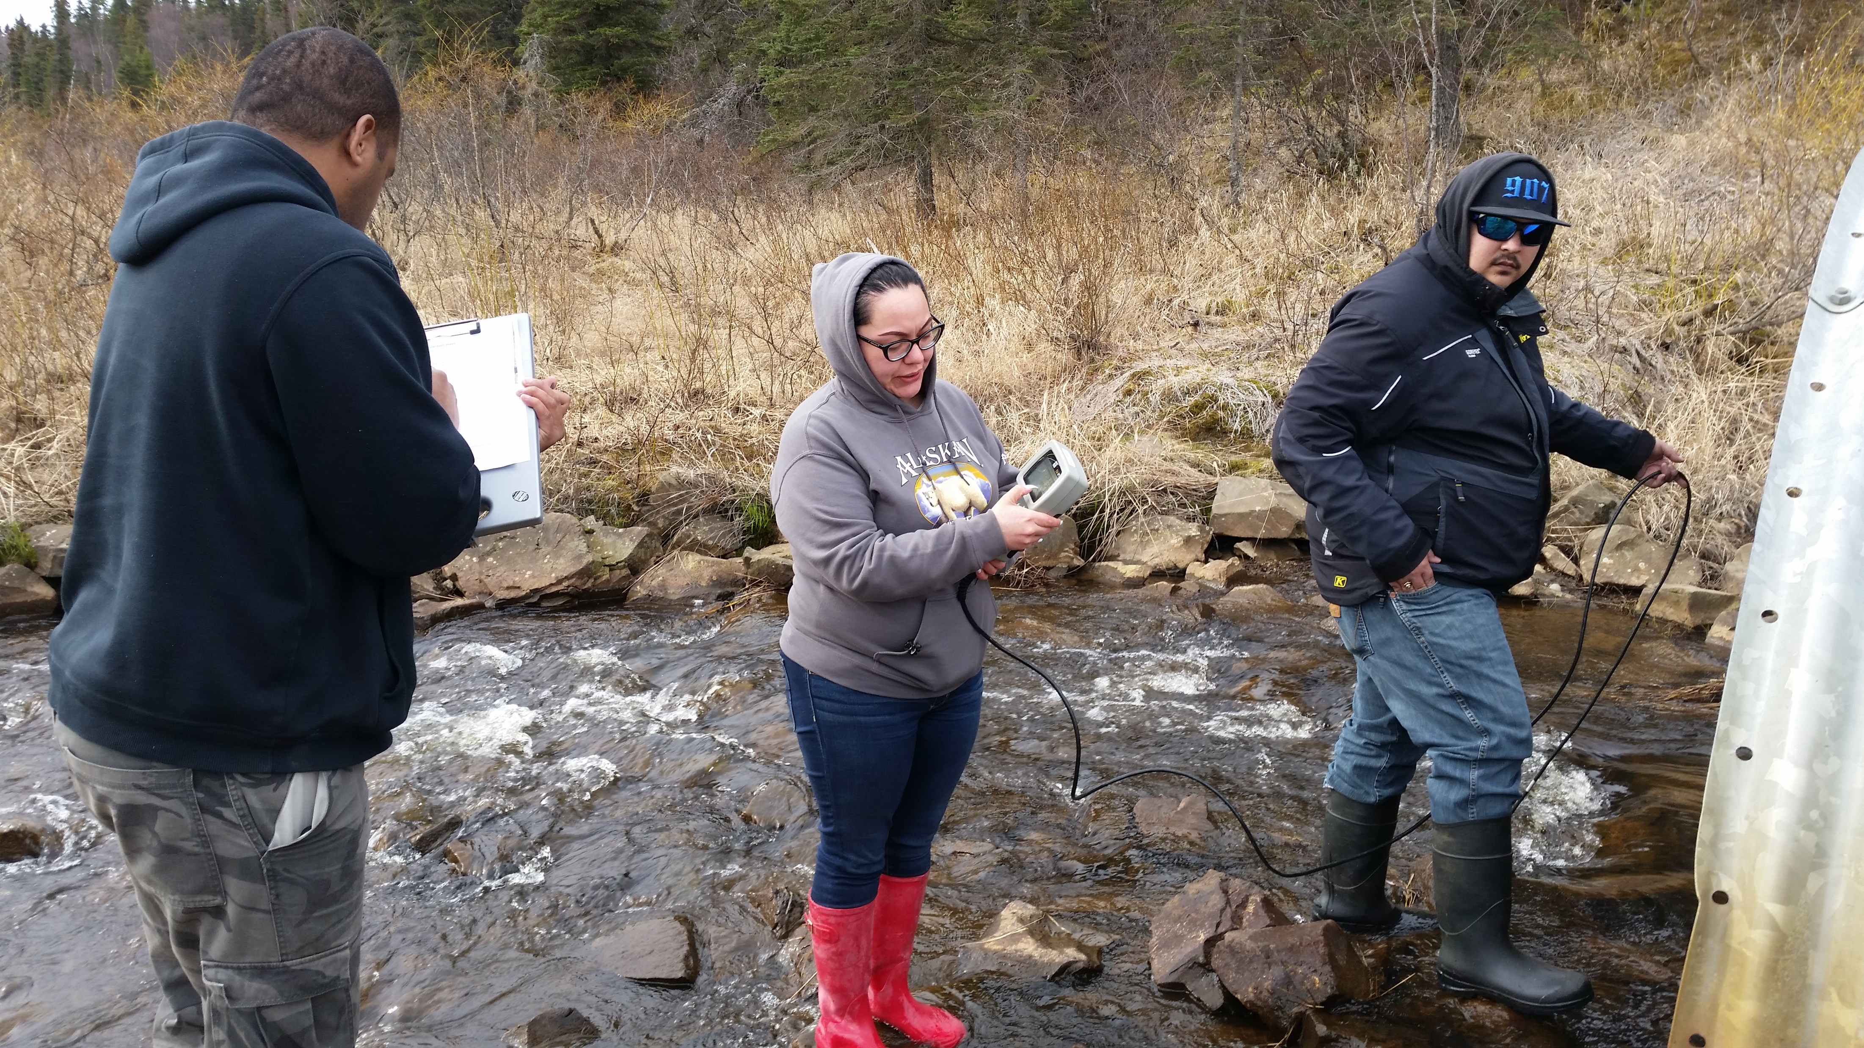
Why Do you Need a
Sampling Program?
The answer should not be “because it is in my workplan!”
What do you hope to accomplish?
Typical reasons for starting a sampling program
  Collect baseline data
  Document current contamination
  Ease community fears
Hold community meetings to get input from residents, talk to Village Council members and/or city officials
Ensure you have a well thought out purpose that reflects your community's concerns and feedback!

Slide 5
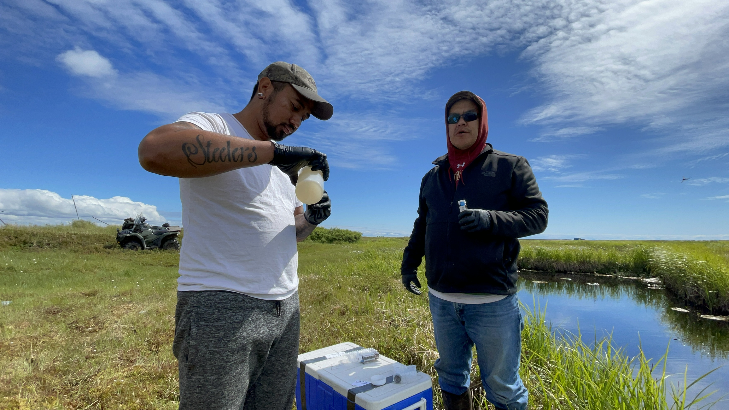
Who is Going to Participate in Your Sampling Program?
Who is going to do what (roles and responsibilities)
  Who is going to collect the samples?
  Who is going to enter all the data in Excel?
  Who is going to provide technical assistance to you?
  If you are going to collect laboratory samples, which lab are you going to work with?
  Who is going to transport those samples so they arrive on time?
Can the person to whom you are assigning the role actually perform the task(s)?

Slide 6
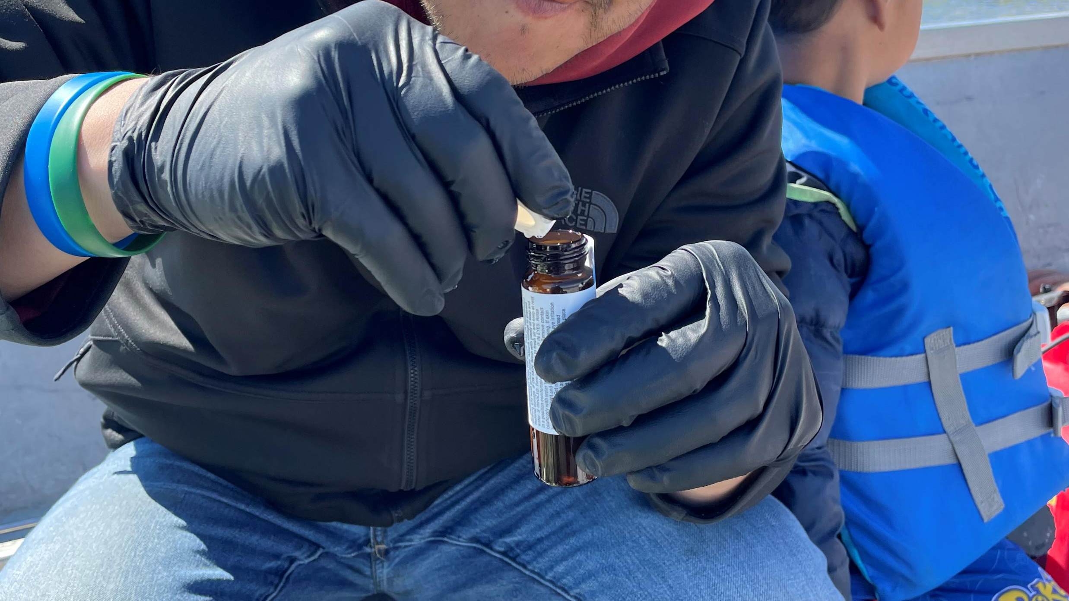
What type of Sampling are you Going to Perform?
Are you going to be sampling the surface water, groundwater, soil – or some combination of all 3
Understand the implications that go along with the medium you are choosing to sample:
  Groundwater sampling may require the installation of a groundwater monitoring well and the use of extensive equipment, which = $$$$
  Surface water data collection may require the purchase of equipment such as a YSI
  Depending on the depth of which you are collecting samples from, soil sampling may require the use of heavy equipment

Slide 7
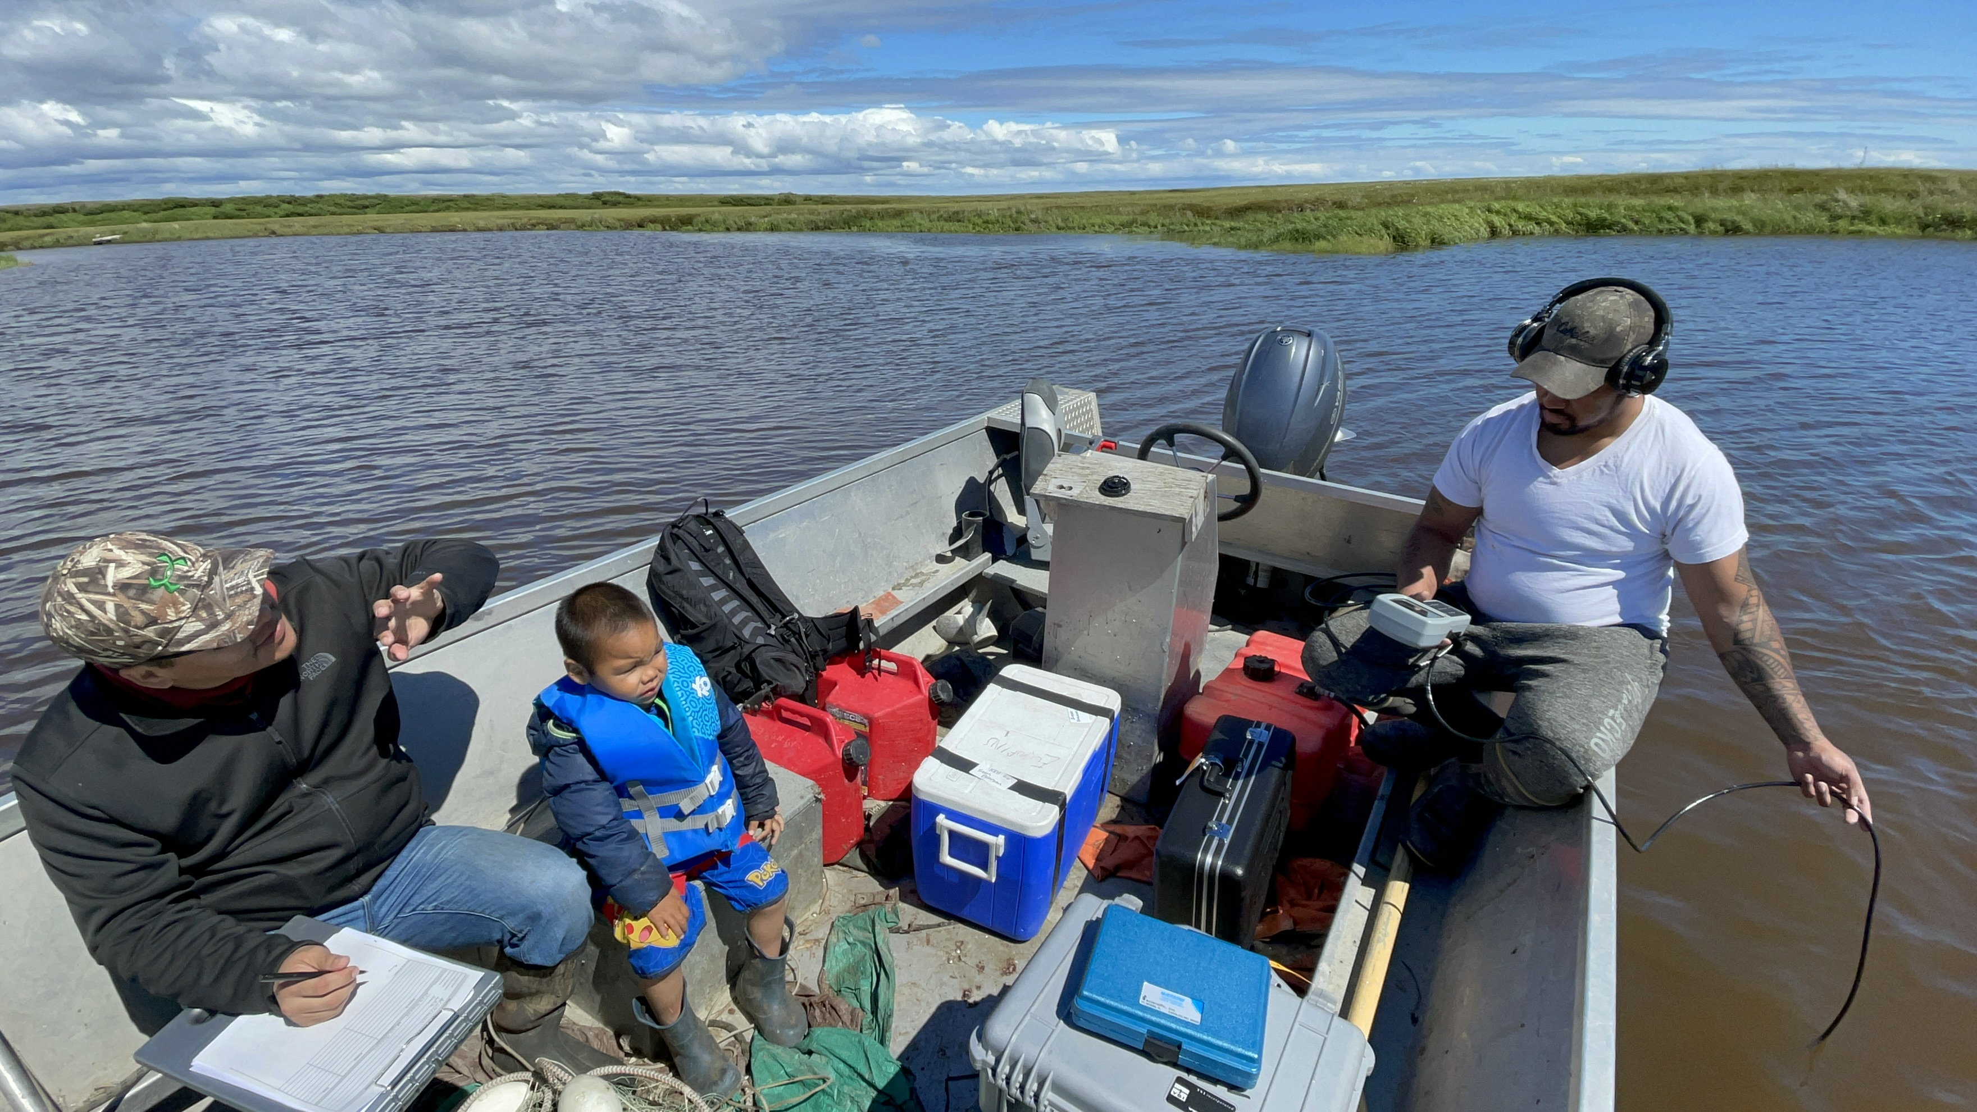
When will Samples be Collected?
When deciding when to collect your samples, keep in mind:
  Seasonal variations are important to document if collecting samples for baseline data
  Soil and groundwater samples are much more difficult to collect during the winter months
  Site access may be more difficult or even dangerous during certain months of the year (i.e. early spring/breakup)

Slide 8
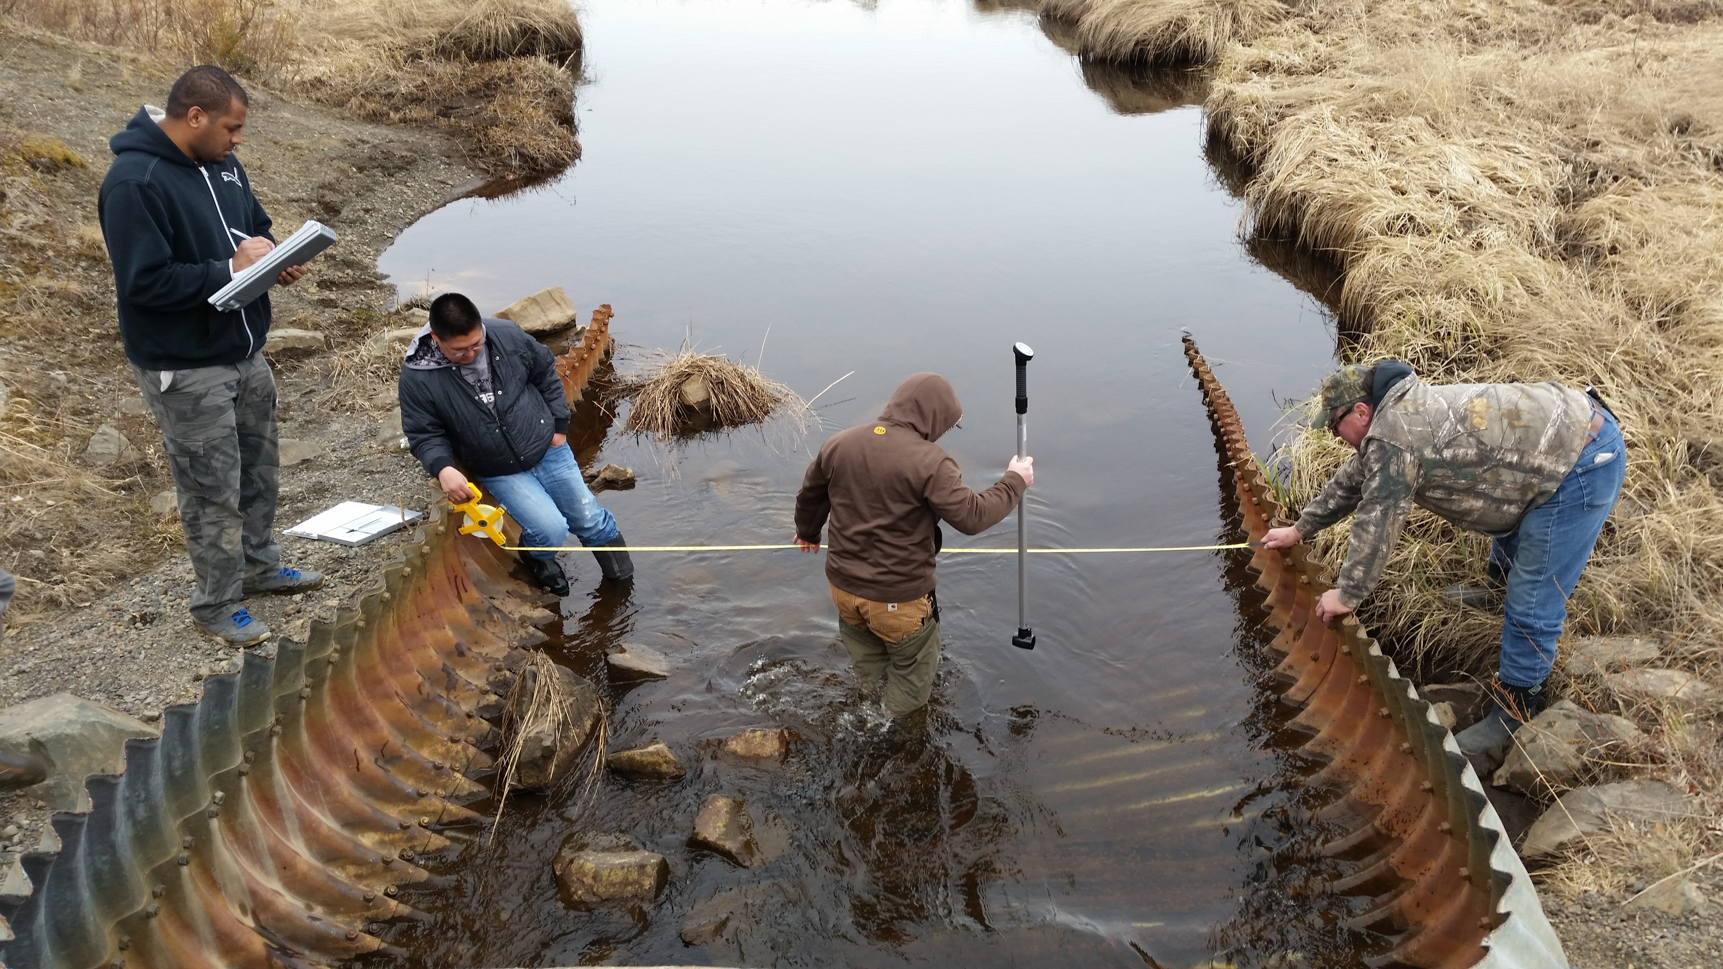
Where will you be collecting samples from?
Understand what type of samples you are collecting and what part of your environment they will be representing
Make field reconnaissance trips before selecting sampling sites
Review existing data

Slide 9
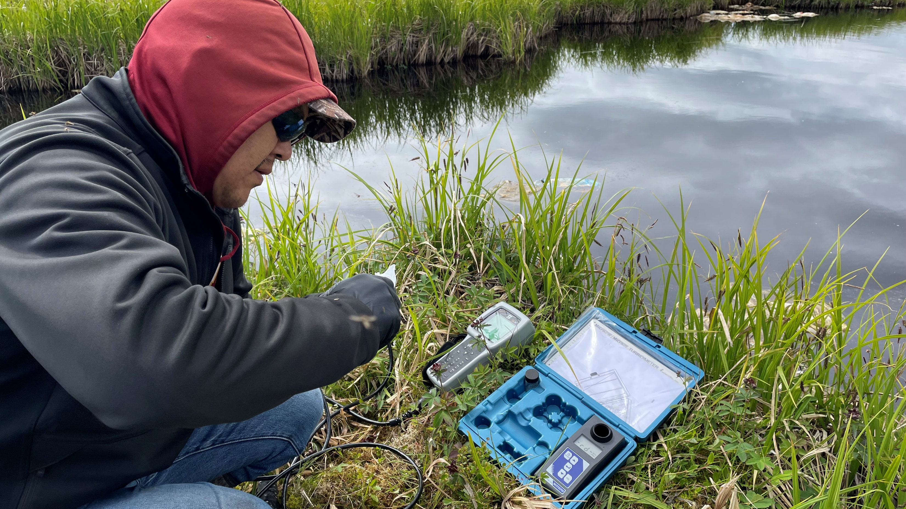
    How will you collect your data/samples?
Water Quality Parameters
Typically collected using field equipment such as the YSI, Hanna Meter or turbidity meter
Can provide clues to potential contamination but cannot provide you with a specific contaminant or concentration
Laboratory Samples
Can help you determine the concentration of a specific contaminant
Can be cost prohibitive depending on the number of analysis you are looking to run

Slide 10
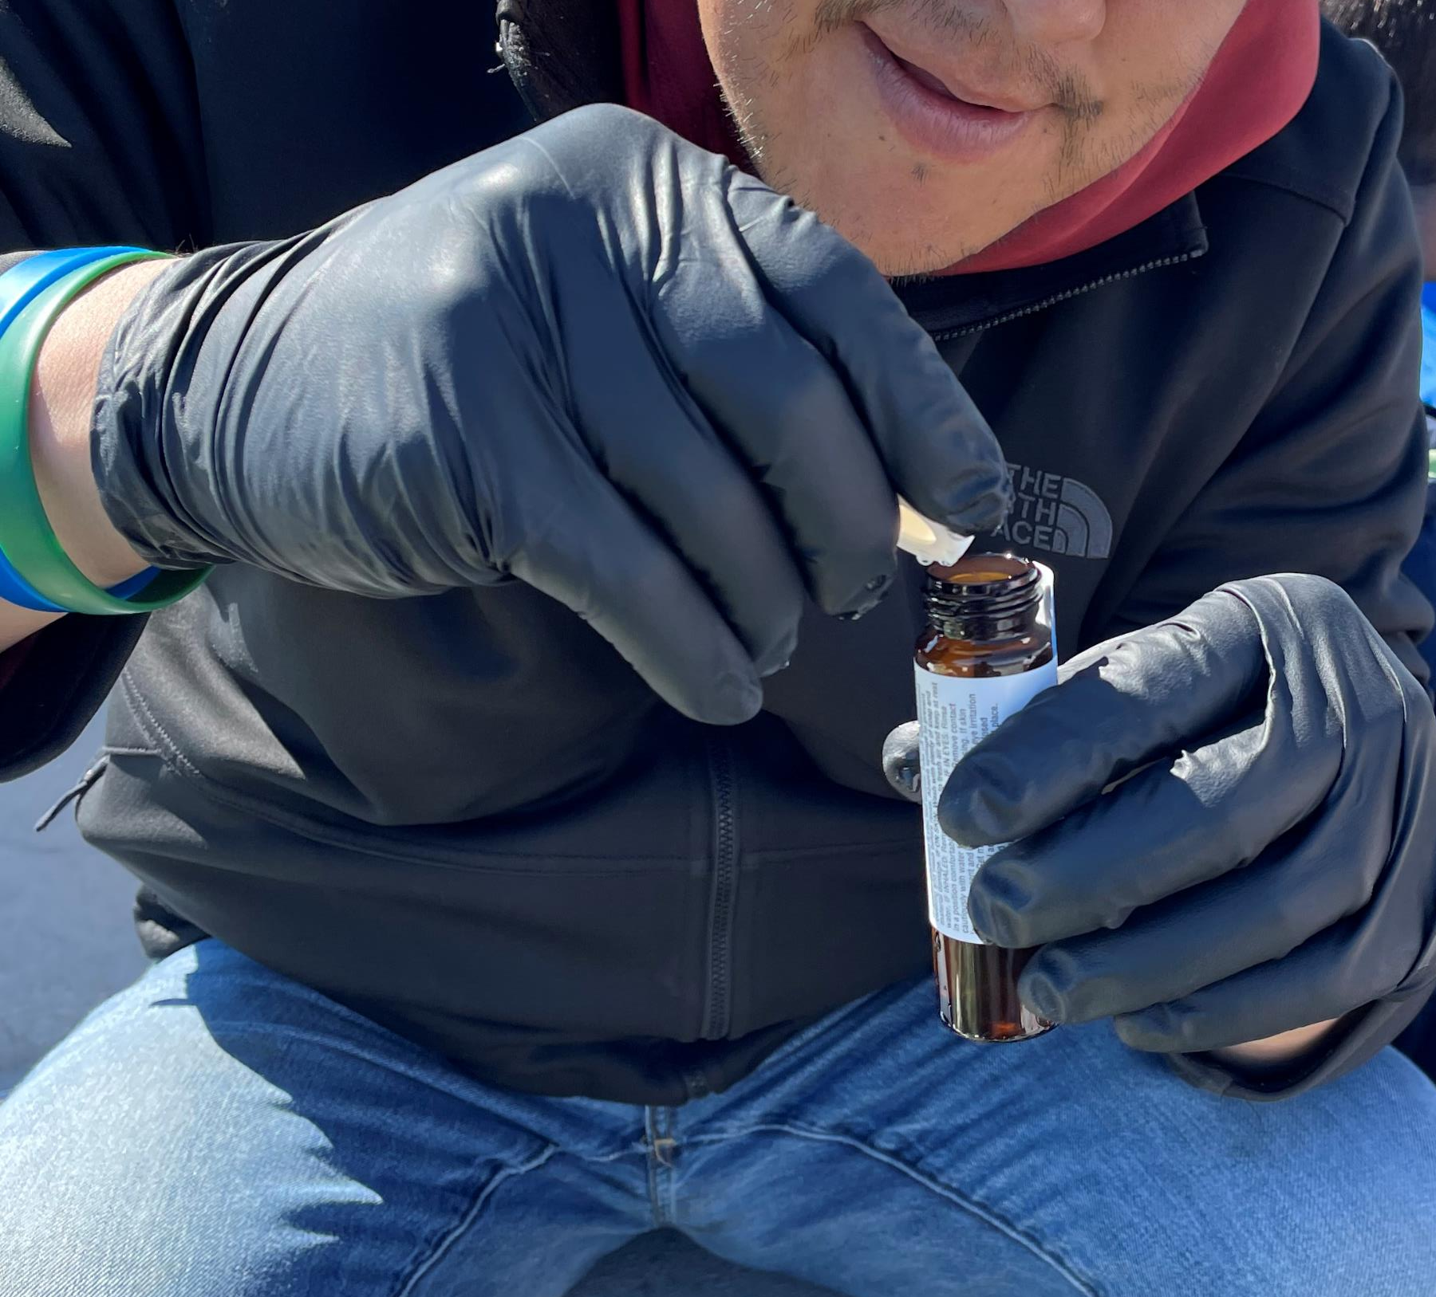
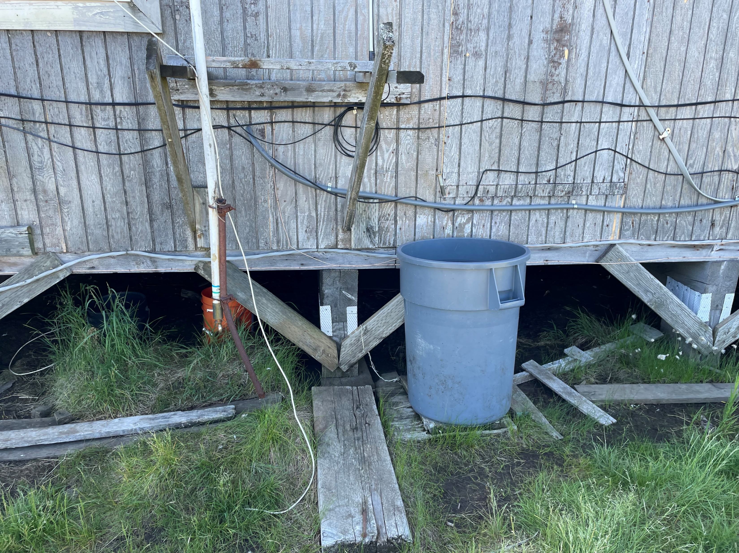
Sampling Success Story
Developed QAPP
Received Training
Collected Samples & Data
Received Actionable Results

Slide 11
Resources
EPA - https://www.epa.gov/r10-tribal/quality-assurance-project-plans-tribes-region-10
EPA Training & TA - https://www.epa.gov/r10-tribal/training-and-technical-assistance-tribes-region-10
Zender - https://zendergroup.org/a-z-topic-help/water-quality-related-information/
ITEP - https://www7.nau.edu/itep/main/air/air_aqt_qapp

Slide 12

Questions?

